Slide 1
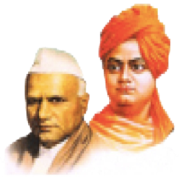
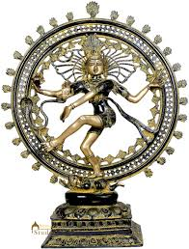
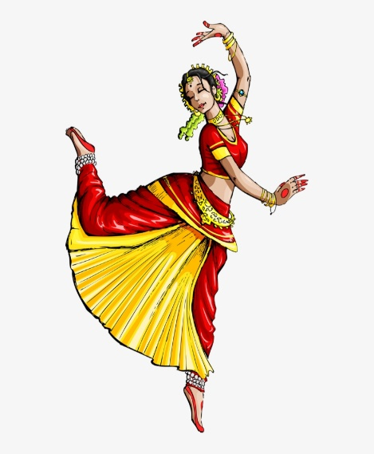
Dattajirao Kadam Arts, Science and Commerce
College, Ichalkaranji
wel-come NAAC PEER TEAM by
CULTURAL DEPARTMENT 2025
“Dissemination of Education for Knowledge, Science & Culture” -Shikshanmaharshi Dr. Bapuji Salunkhe

Slide 2
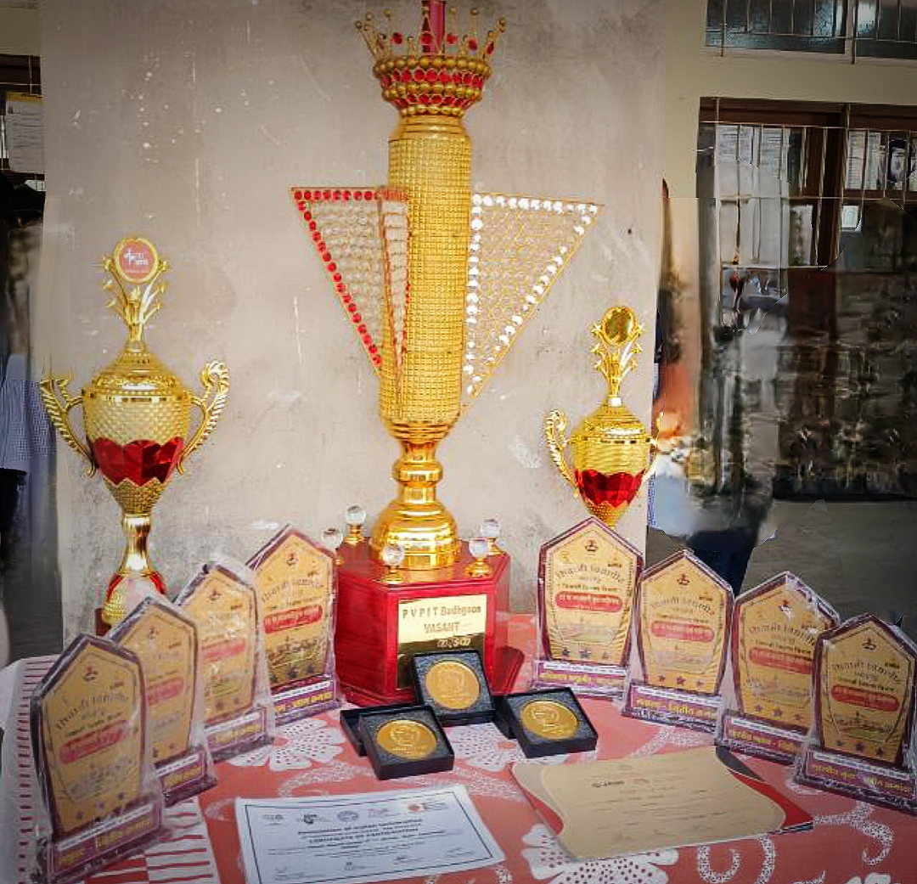
Achievements
Awards and Recognition:
Cultural Department of D.K.A.S.C.College Ichalkaranji

Slide 3
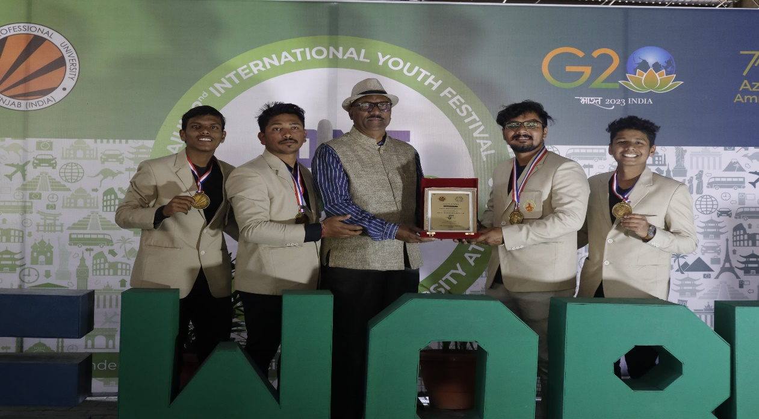
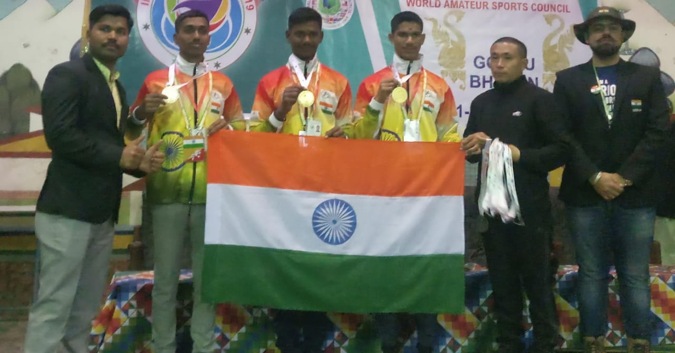
International Level
Mahesh Gavandi, Tushar Patil, Swapnil Jantre & Yashraj Patankar selected in Shivaji University team for AIU Youth Festival at Lovely Professional University, Punjab.
College team selected for International Level Competition in Bhutan.

Slide 4
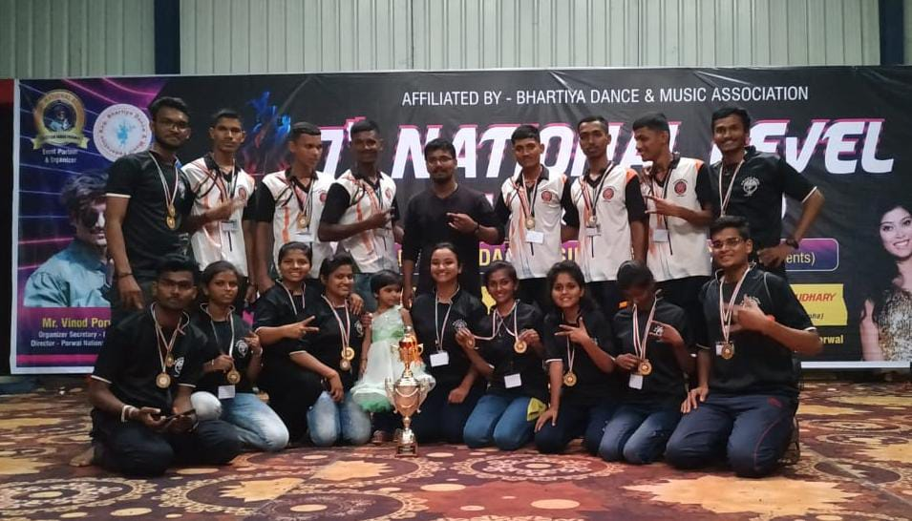
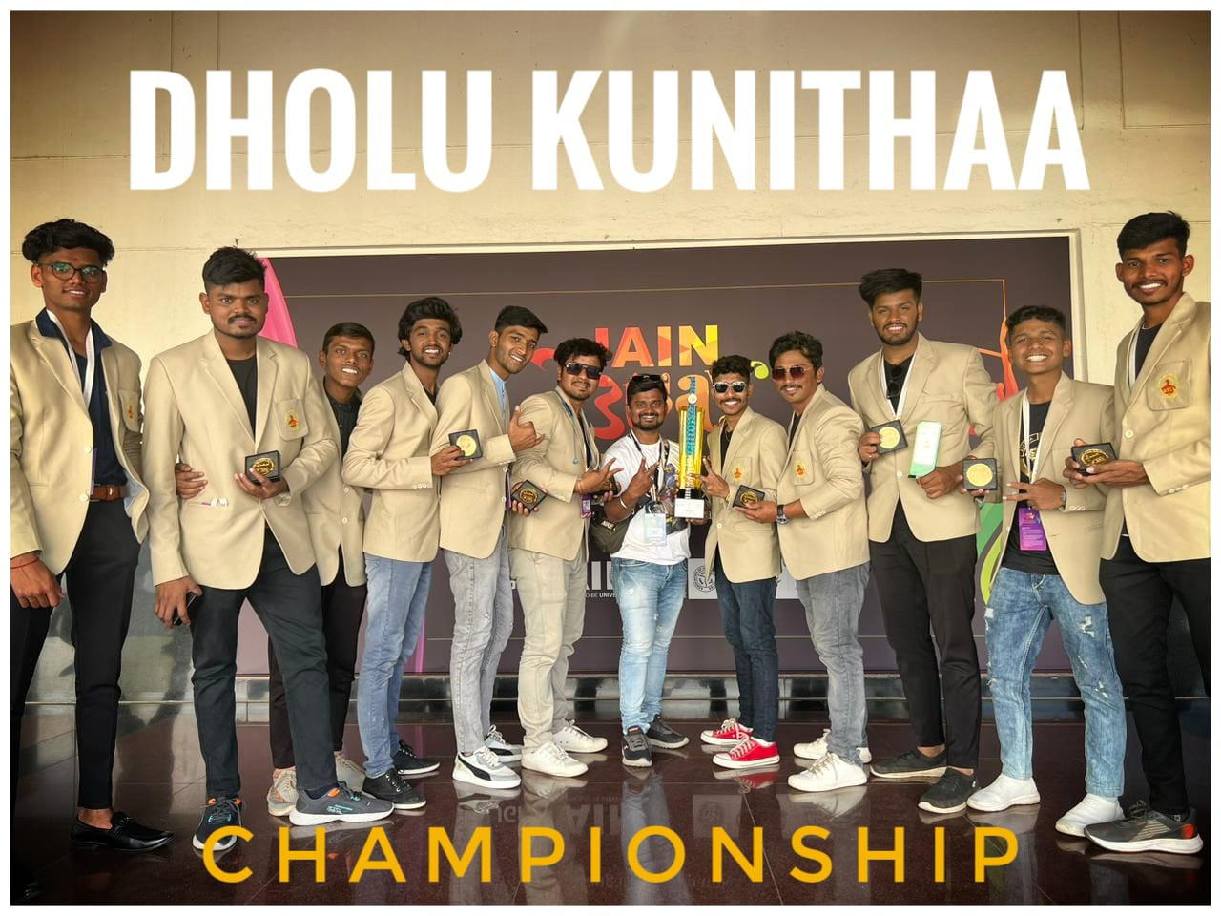
National Level
Our students selected in Shivaji University team for 36th Inter-University National Youth Festival at Jain University, Banglore.
Won National Level General Championship at Bharat Cultural Event, Ratlam (MP)

Slide 5
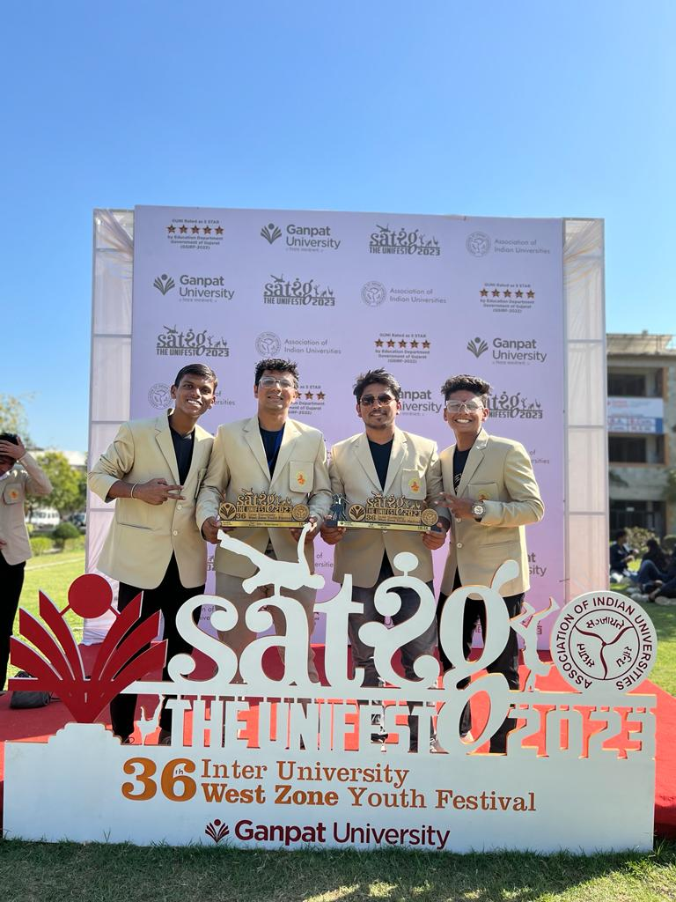
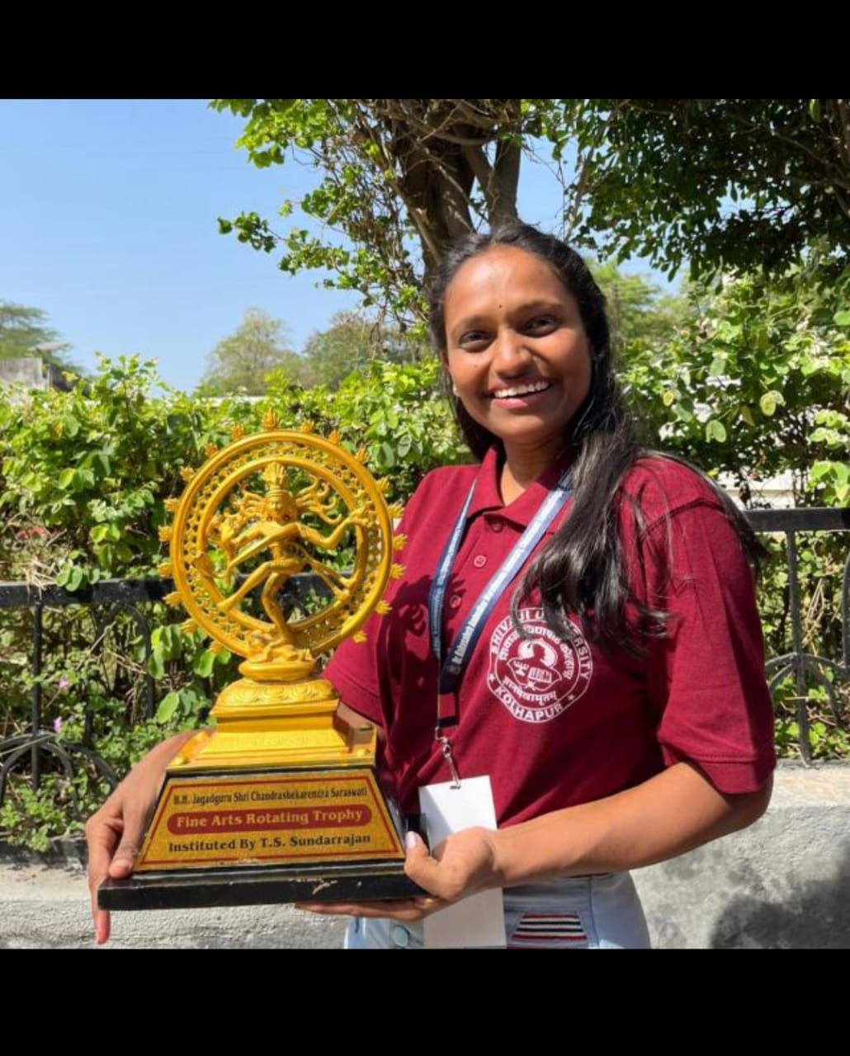
West Zone Level
Our students selected in Shivaji University team for 36th Inter-University West zone Youth festival at Ganpat University, Gujrat
Suchita Tarlekar participated in collage competition for 37th Inter-University West zone Youth festival at RTMU, Nagpur

Slide 6
2019-20
Sr. No. | Name of the award / medal | Team / Individual | Level of competition (University / State / National / International) | Nature of competition
1 | 2nd | Group | University,Yuth Festival | Folk Dance
2 | 2nd | Group | University,Yuth Festival | Group Installation
3 | 1st | Group | National Owened General Championship All india level Ratlam MP | Group
4 | 2nd | Individual | State, CM Chashak Ichalkarnji | Singing
5 | 2nd | Individual | State, CM Chashak Ichalkarnji | Solo Dance
6 | 1st | Group | State, CM Chashak Ichalkarnji | Group Dance
7 | 1st | Group | State, Yuva Spandhan Ichalkaranji | Group Dance
8 | 3rd | Group | State Level, Purushottam Karandak Pune | Group
9 | 2nd | Group | State, Csiber College Kolhapur | Group Dance
10 | 1st | Group | State, Vasant Karandak Pune | Group Dance
11 | 1st | Group | State, Vasant Karandak Pune | Street Play
12 | 1st | Individual | State, Vasant Karandak Pune | Photography
13 | 1st | Group | State, Vibrant Dance Chamionship SGUniversity | Group Dance
14 | 1st | Individual | State, Vibrant Dance Chamionship SGUniversity | Photography
15 | 1st | Individual | University, Youth Festival | Spot Painting
16 | 1st | Individual | University, Youth Festival | Rangoli
17 | 2nd | Individual | University, Youth Festival | Western Solo Instrument
18 | 1st | Group | State, Yuvak Biradari Aitvade Khurd | Group Dance
19 | 1st | Individual | National,Inter-Uni.Qawwali Competition | Qawwali

Slide 7
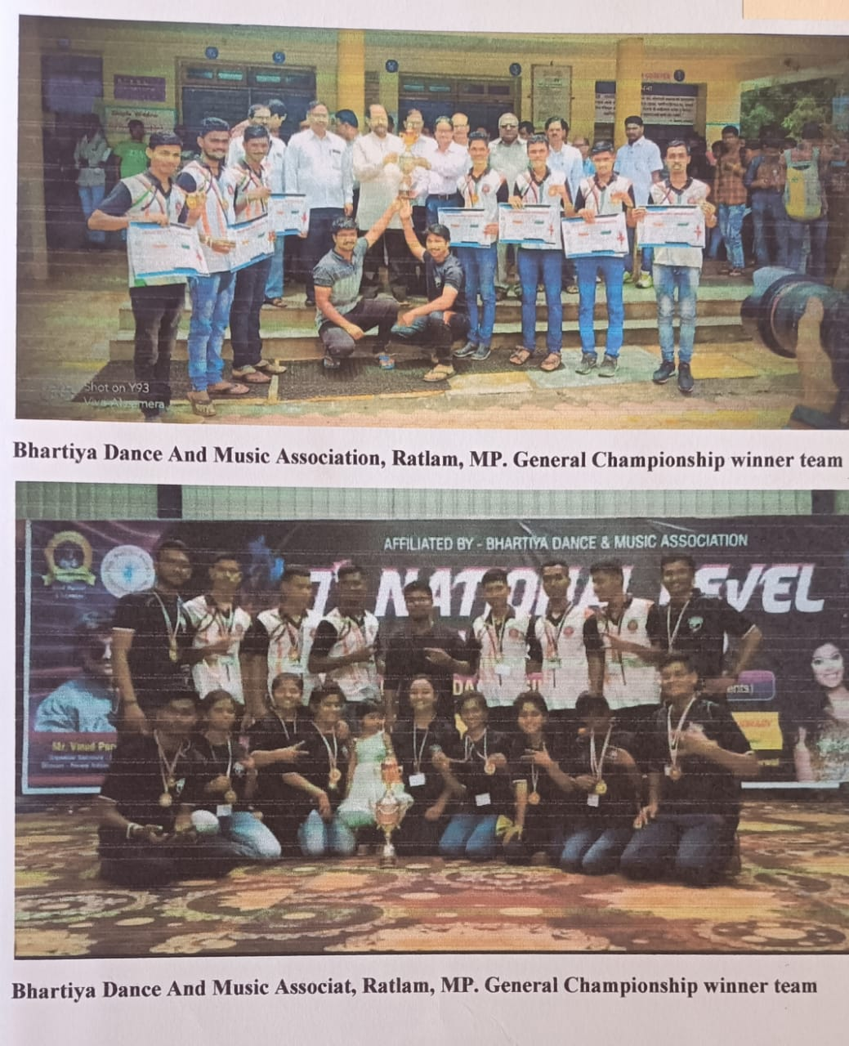
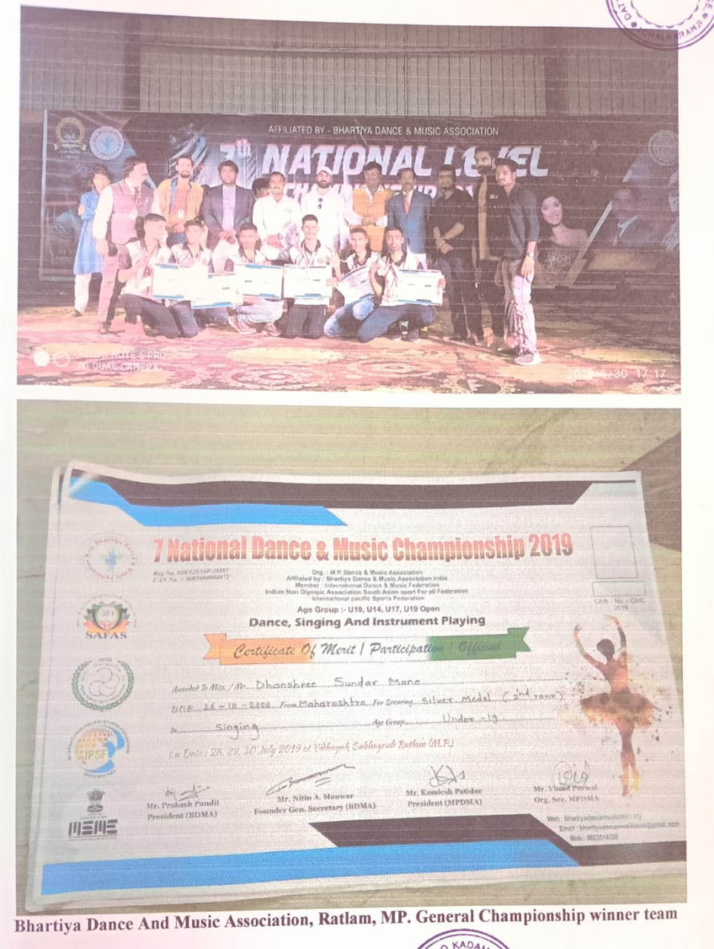
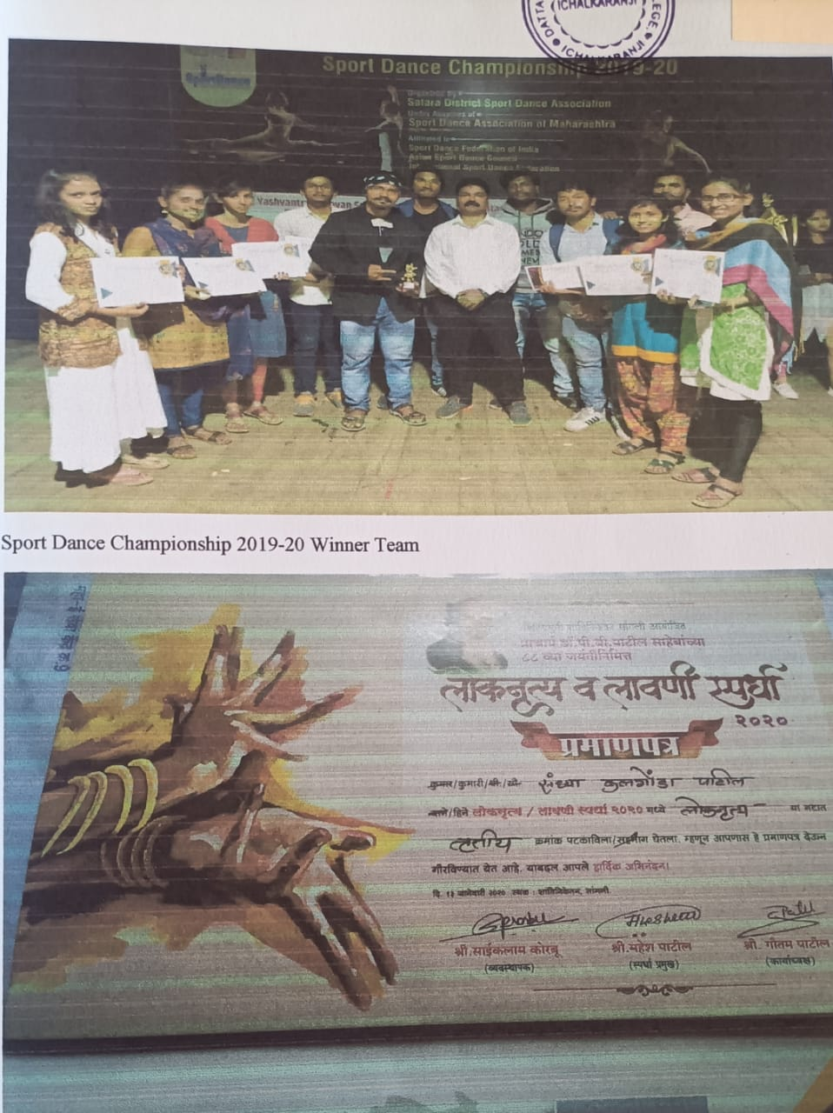
2019-20

Slide 8
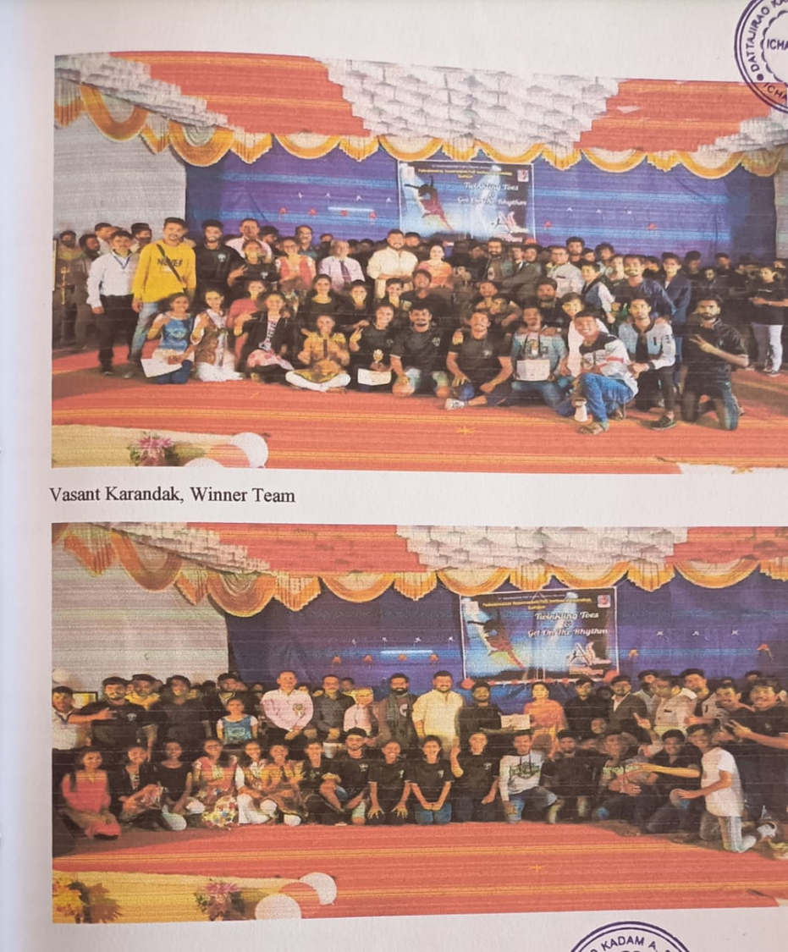
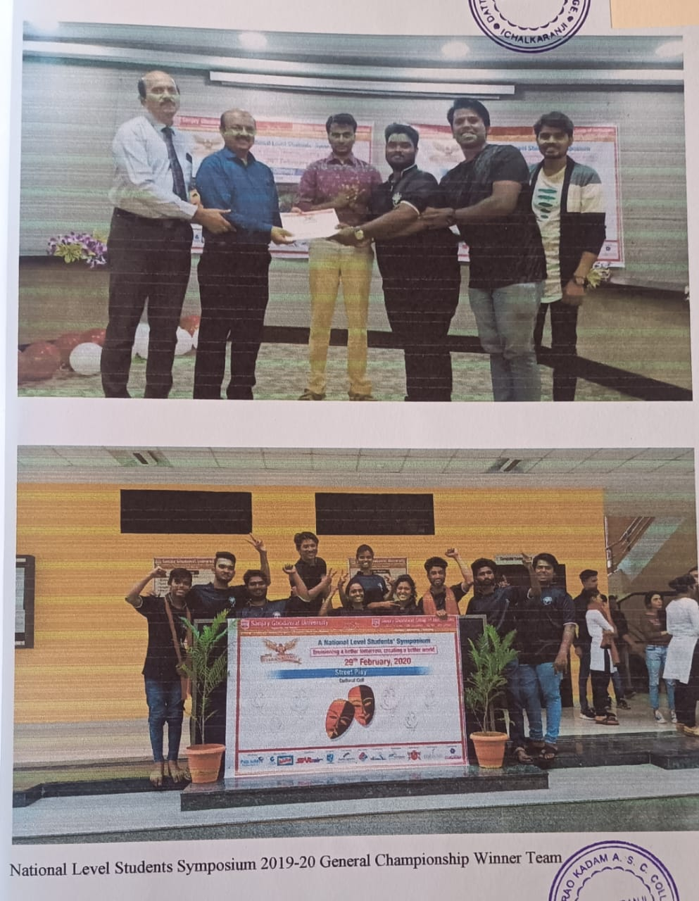
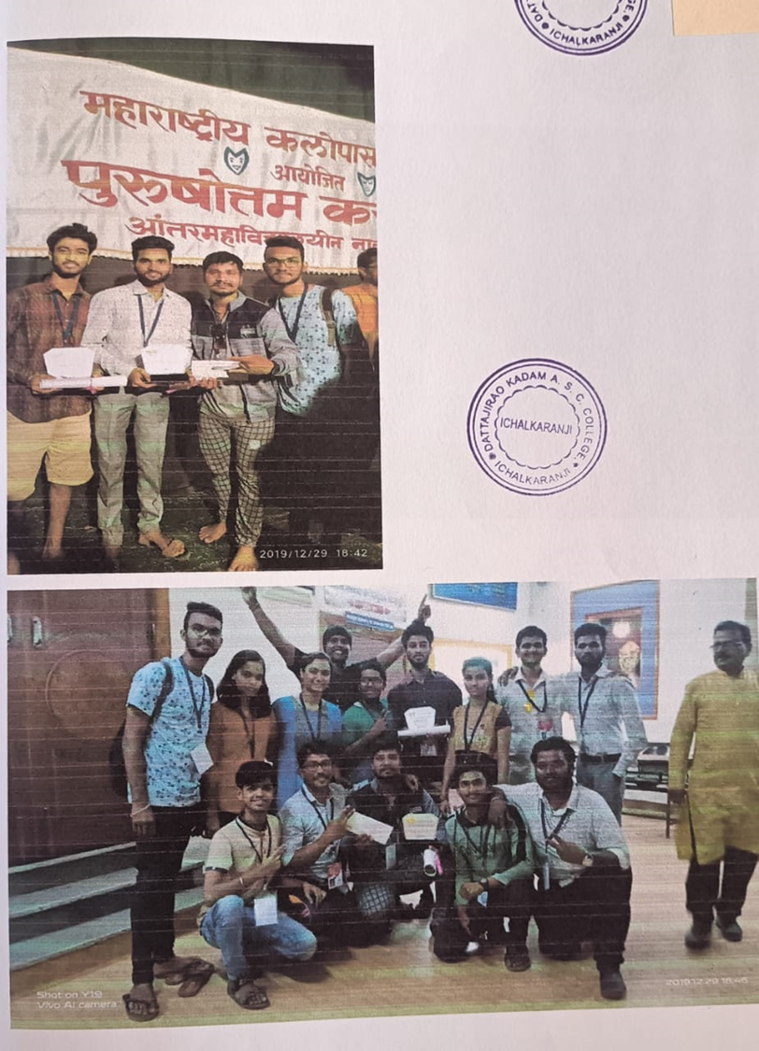
2019-20

Slide 9
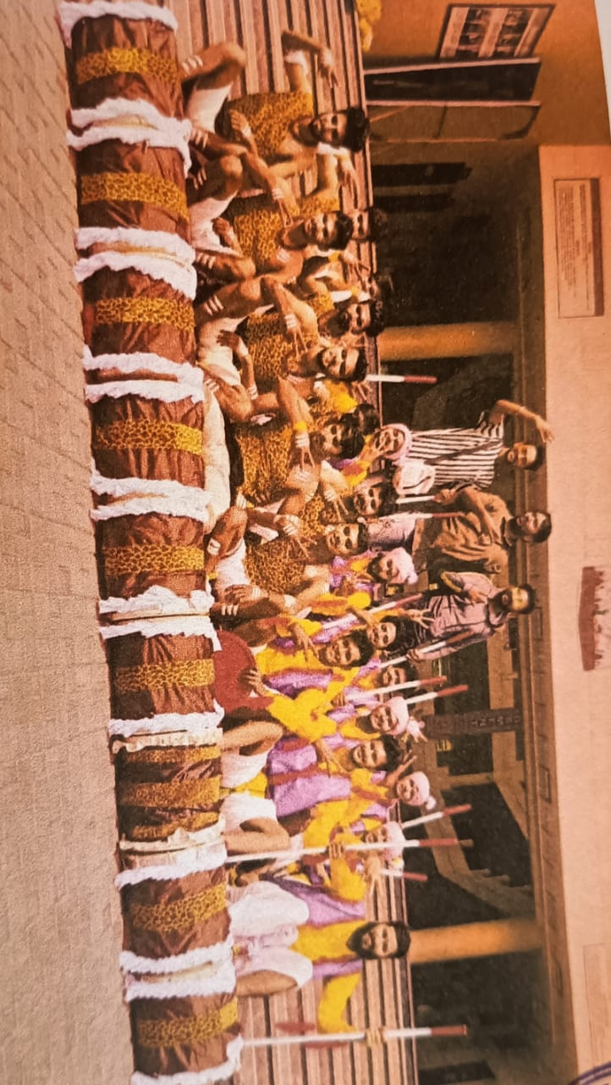
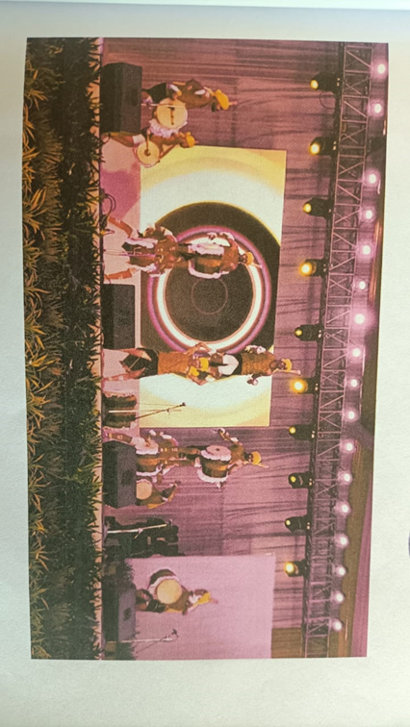
2019-20

Slide 10
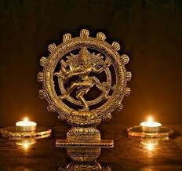
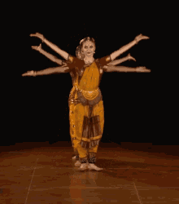
Cultural Department of D.K.A.S.C.College Ichalkaranji

