Slide 1
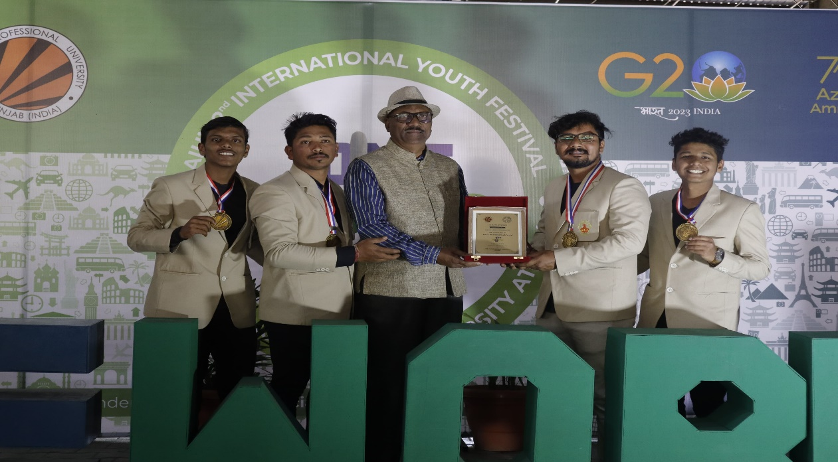
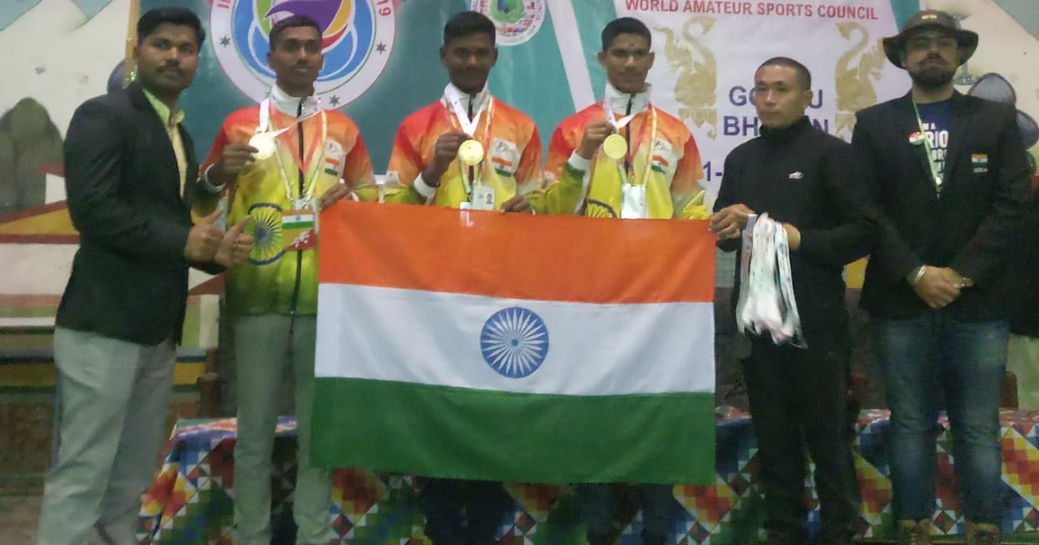
International Level
Mahesh Gavandi, Tushar Patil, Swapnil Jantre & Yashraj Patankar selected in Shivaji University team for AIU Youth Festival at Lovely Professional University, Punjab.
College team selected for International Level Competition in Bhutan.

Slide 2
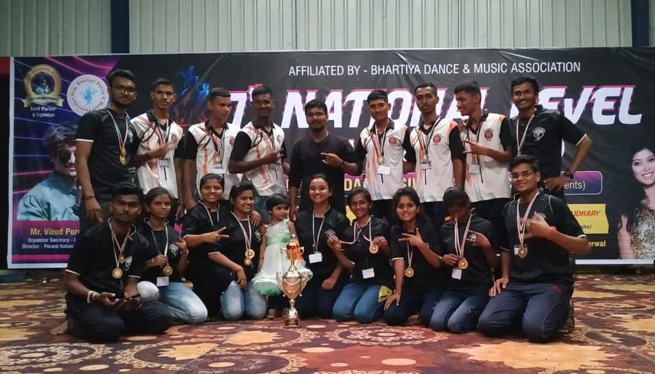
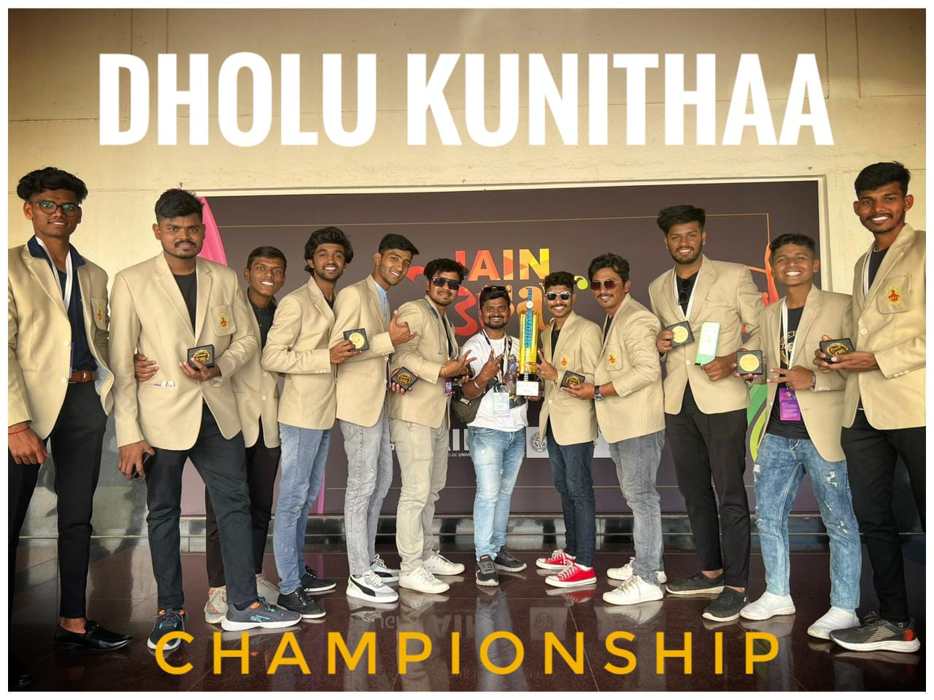
National Level
Our students selected in Shivaji University team for 36th Inter-University National Youth Festival at Jain University, Banglore.
Won National Level General Championship at Bharat Cultural Event, Ratlam (MP)

Slide 3
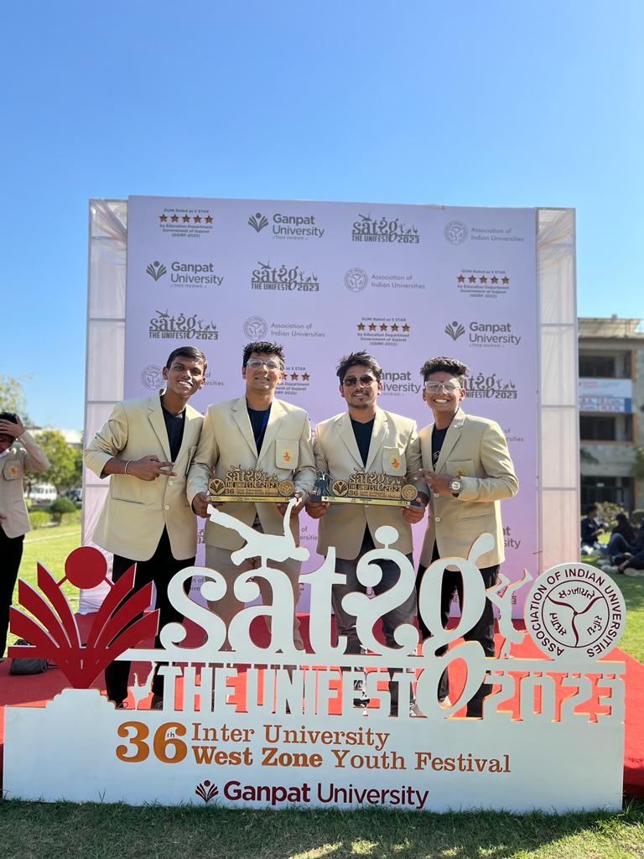
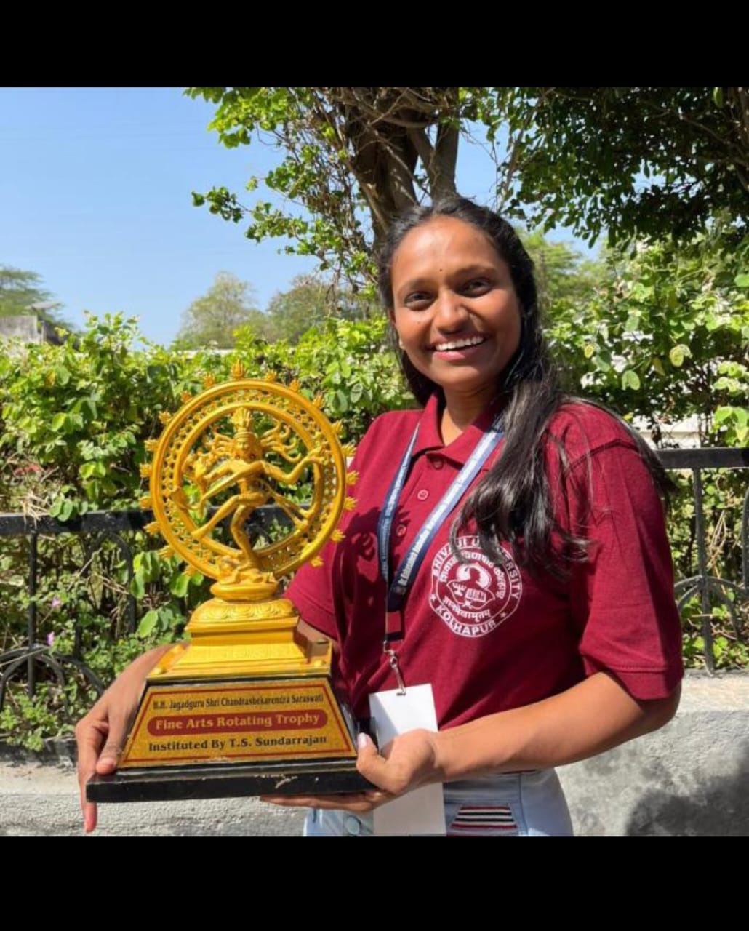
West Zone Level
Our students selected in Shivaji University team for 36th Inter-University West zone Youth festival at Ganpat University, Gujrat
Suchita Tarlekar participated in collage competition for 37th Inter-University West zone Youth festival at RTMU, Nagpur

Slide 4
2020-21
Sr. No. | Name of the award / medal | Team / Individual | Level of competition (University / State / National / International) | Nature of competition
1 | Shahid Tukaram Ombale Vishesh Kala Sahitya & Sanskrutic Pravinya Paritoshik & Smrutichinha | Individual | SUK, University | Cultural
2 | 2nd | Individual | University, SUK | Elocution
3 | 3rd | Individual | University, SUK | Mimicry
4 | 3rd | Individual | University, SUK | Kolas
5 | 2nd | Individual | University, SUK | Rangoli
6 | 2nd | Individual | University SUK | Matikam
7 | 2nd | Individual | Madhyavarti Yuva Mahotsav | Hindi Vaktrutva
8 | 3rd | Individual | Madhyavarti Yuva Mahotsav | Mimicry
9 | 3rd | Individual | Madhyavarti Yuva Mahotsav | Katarkam
10 | 2nd | Individual | Madhyavarti Yuva Mahotsav

