Slide 1
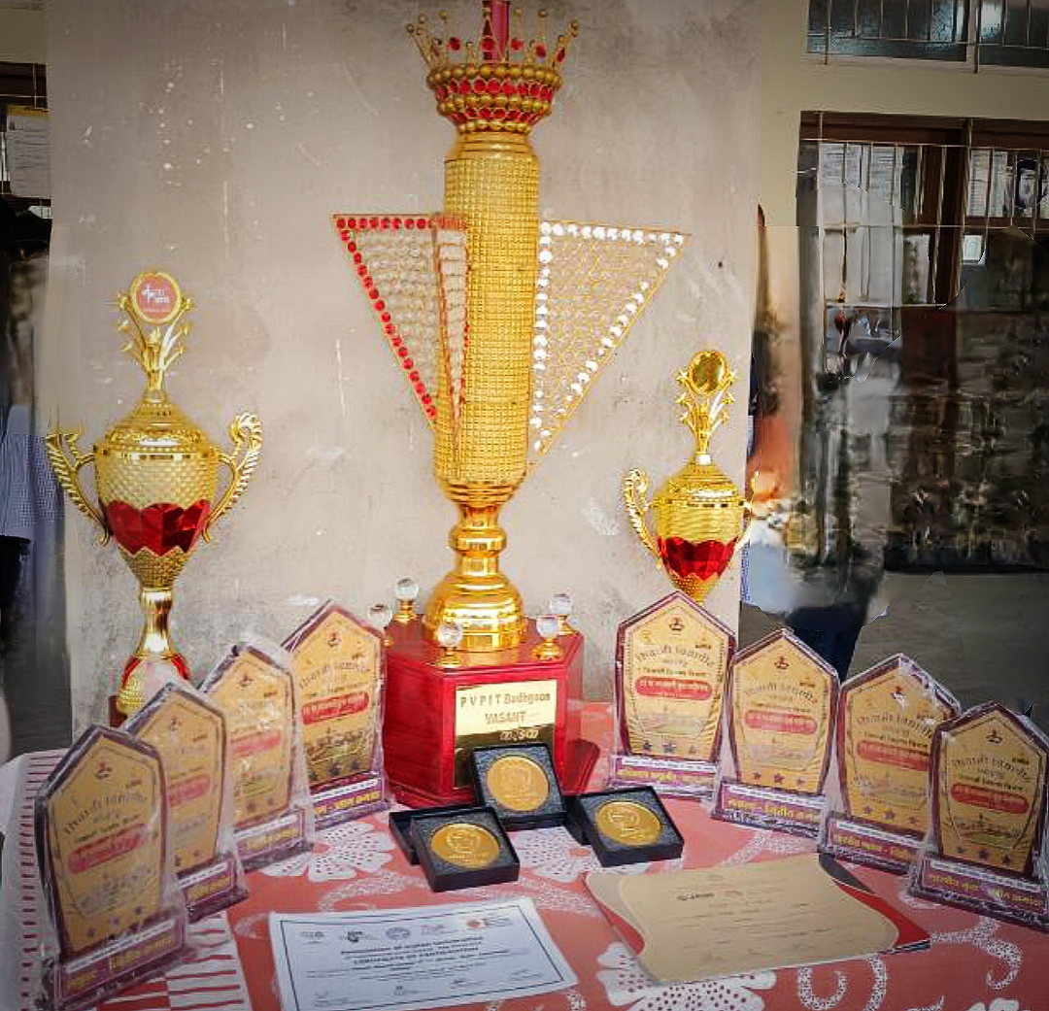
Achievements
Awards and Recognition:
Cultural Department of D.K.A.S.C.College Ichalkaranji

Slide 2
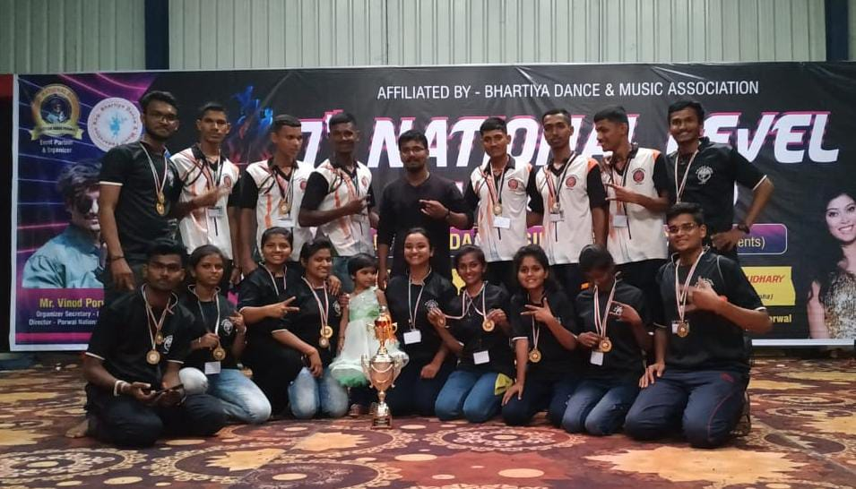
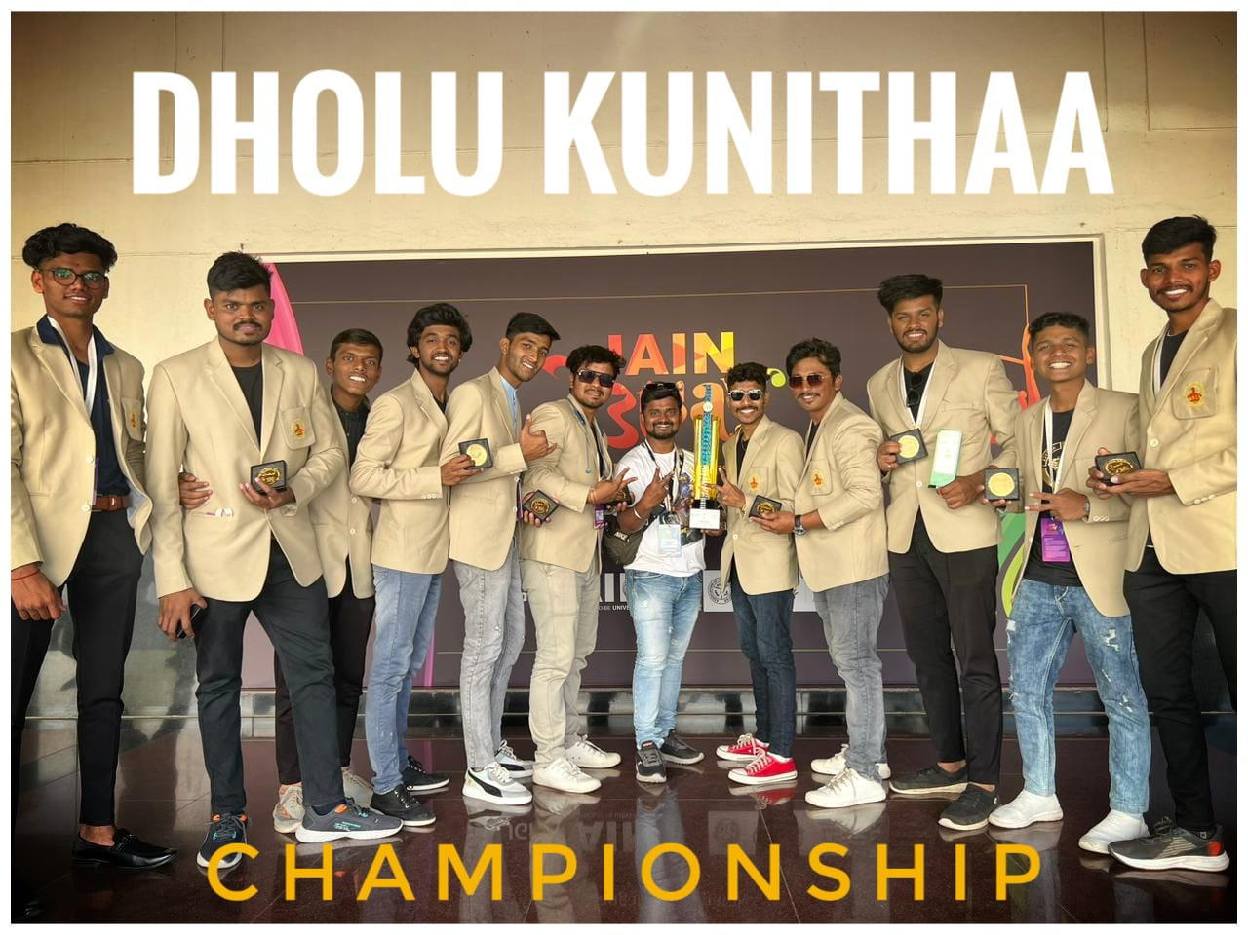
National Level
Our students selected in Shivaji University team for 36th Inter-University National Youth Festival at Jain University, Banglore.
Won National Level General Championship at Bharat Cultural Event, Ratlam (MP)

Slide 3
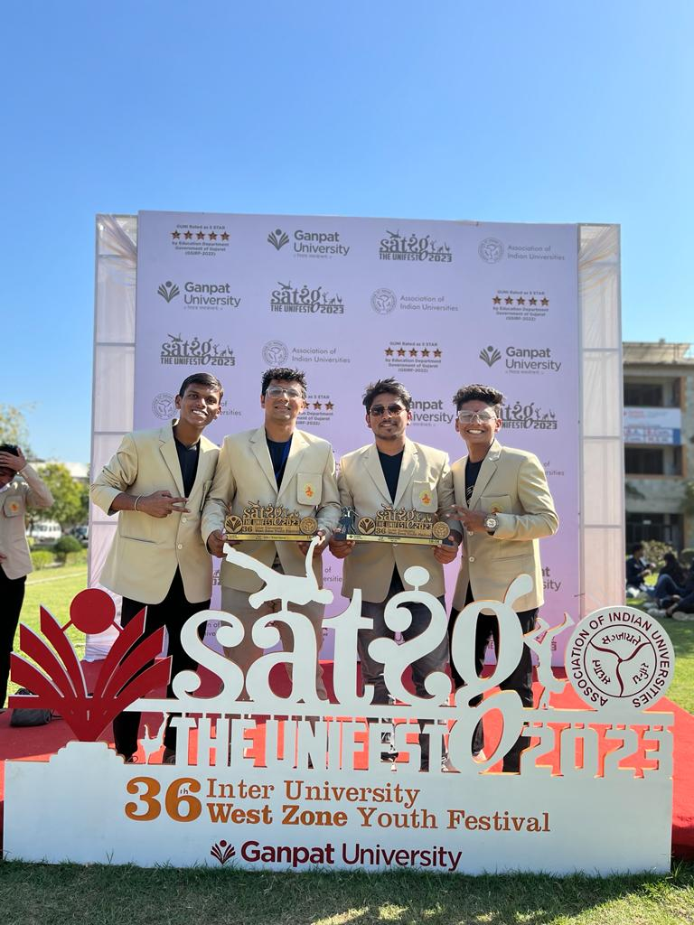
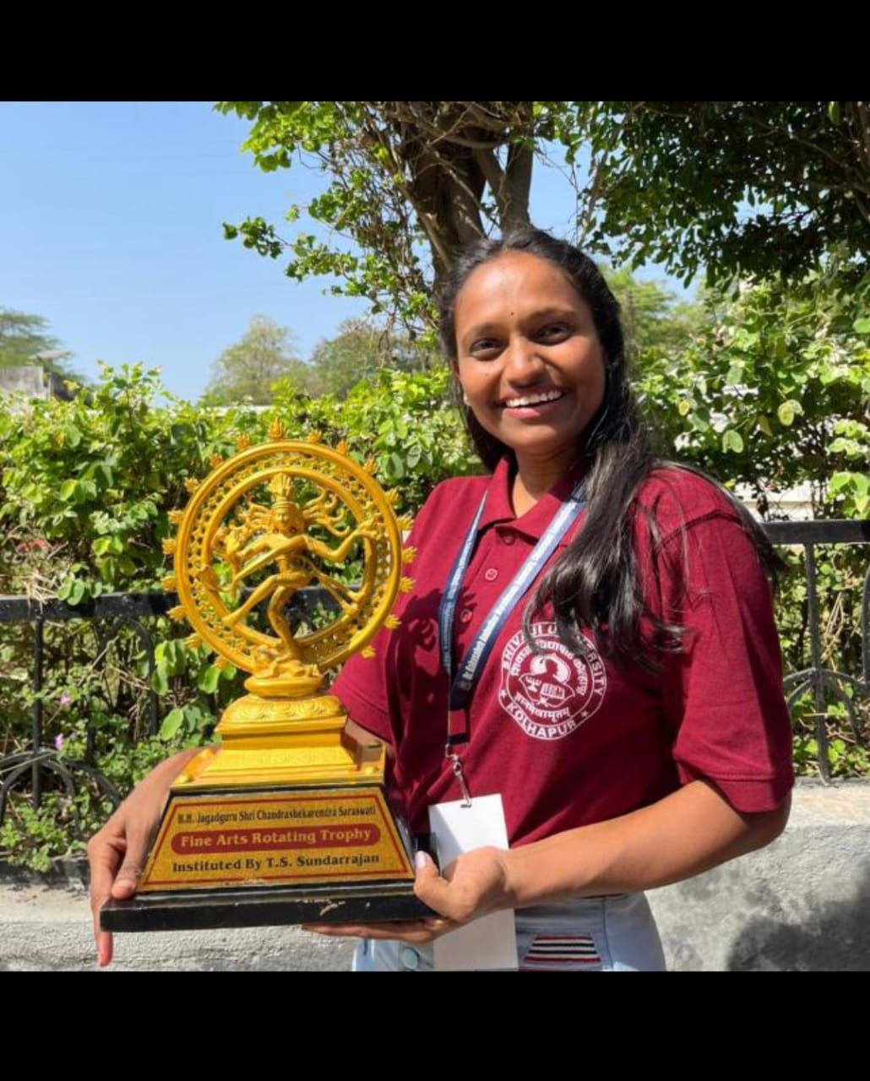
West Zone Level
Our students selected in Shivaji University team for 36th Inter-University West zone Youth festival at Ganpat University, Gujrat
Suchita Tarlekar participated in collage competition for 37th Inter-University West zone Youth festival at RTMU, Nagpur

Slide 4
2021-22
Sr. No. | Name of the award / medal | Team / Individual | Level of competition (University / State / National / International) | Nature of competition
1 | Gold Medal/ 1st Rank | Team | University | Kolhapur District Youth Festival One Act play
2 | Gold Medal/1st Rank | Team | University | Kolhapur District Youth Festival(Mime)
3 | Gold Medal/1 st Rank | Team | University | Kolhapur District Youth Festival (Group Installation)
4 | Bronze Medal | Team | University | Kolhapur District Youth Festival(Street Play)
5 | Silver Medal | Individual | University | Spot Painting
6 | Gold Medal | Individual | University | Central Youth Festival Mehandi
7 | Consolation | Individual | University | Central Youth Festival Collage
8 | Gold Medal | Individual | University | Central Youth Festival Clay Modeling
9 | Gold Medal | Team | Other Institution State Level | Purshottam Karandak
10 | Gold Medal | Team | Other Institution State Level | Sharad Mahotsav
11 | Gold Medal | Team | Other Institution State Level | Rasavanti Karandak
12 | 1st | Individual | SUK | 2021-22 Vivek Magazine Competition,Rank 1st Interview
13 | 3rd | Individual | SUK | 2021-22 Vivek Magazine Competition,Rank 3rd Biographical Sketch

Slide 5
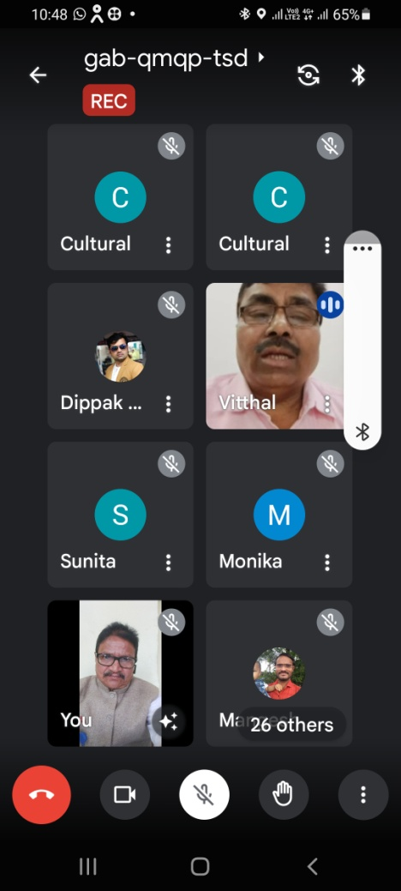
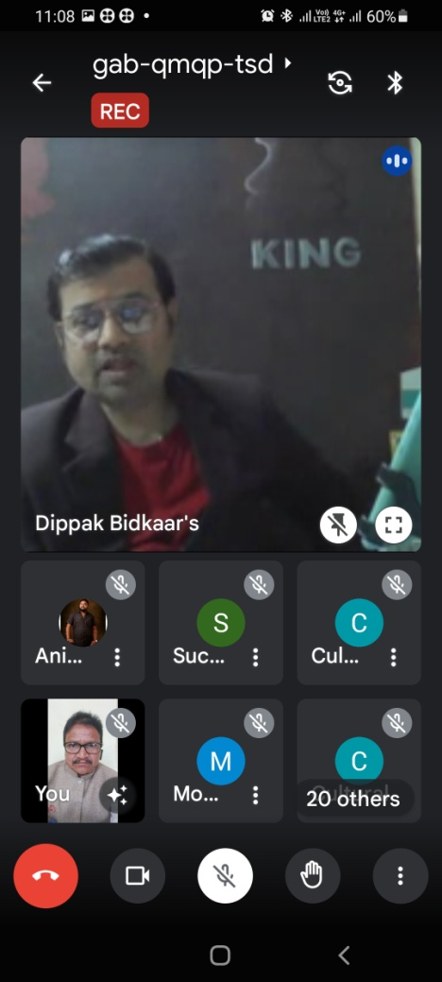
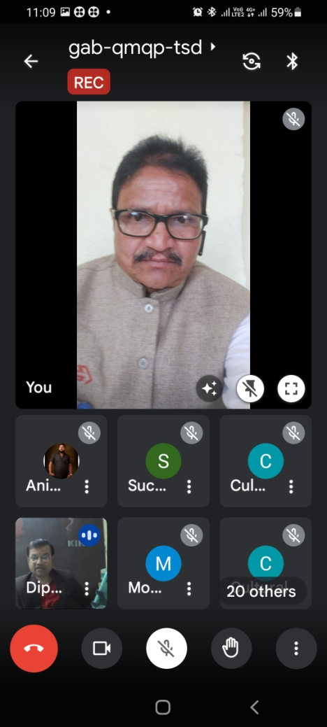
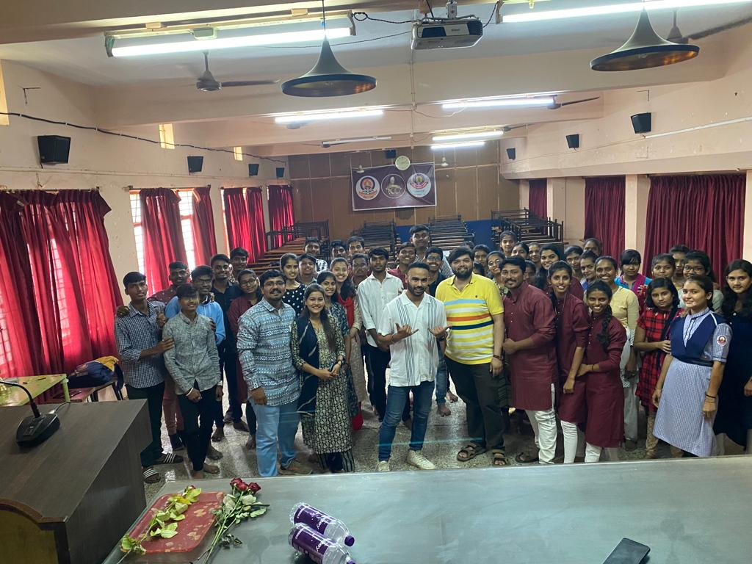
2021-22
One day online workshop on ‘Dance and Drama Training’ organized under Lead College Scheme of Shivaji University, Kolhapur. The online workshop will be held at our college on Friday, 21st January, 2022.

Slide 6
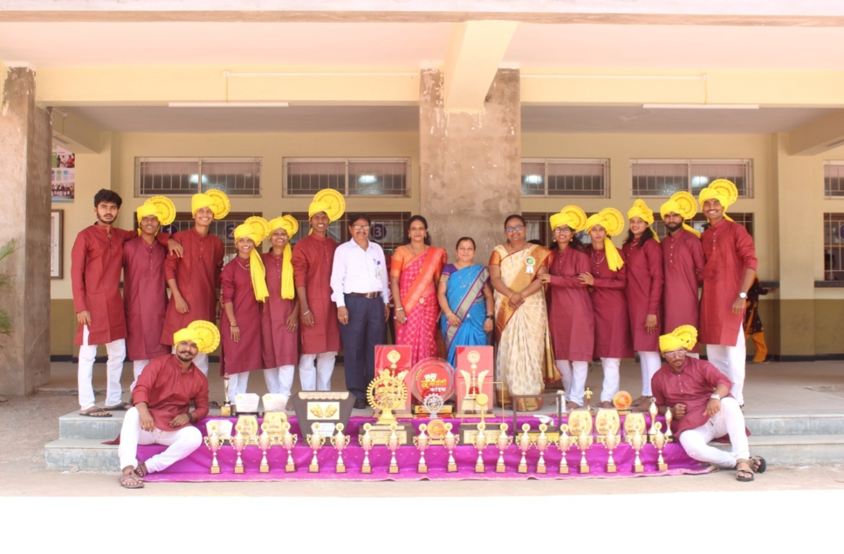
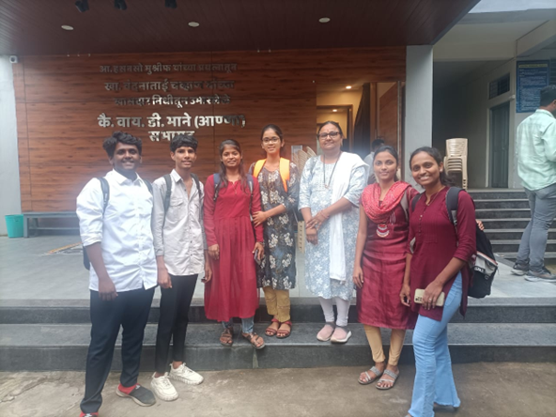
2021-22
Participation in Shivaji University, Kolhapur Central Youth Festival (2021-22):
A total of 40 students participated.
Achievements in group and individual events:
One Act Play – Winner
Mime – Winner
Street Play – Winner
Group Installation – 1st Place
Spot Painting – 1st Place
Rangoli – 1st Place
Spot Photography – 2nd Place
Special Achievements:
Recognized as a major achievement for the Cultural Department.
Won varies prizes and shields
Workshops and Events:
Five students participated in the Youth Festival Workshop 2021-22, organized by Shivaji University, Kolhapur.
Organized a Lead College one-day event.

Slide 7
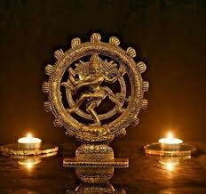
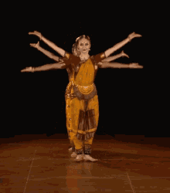
Cultural Department of D.K.A.S.C.College Ichalkaranji

