Slide 1
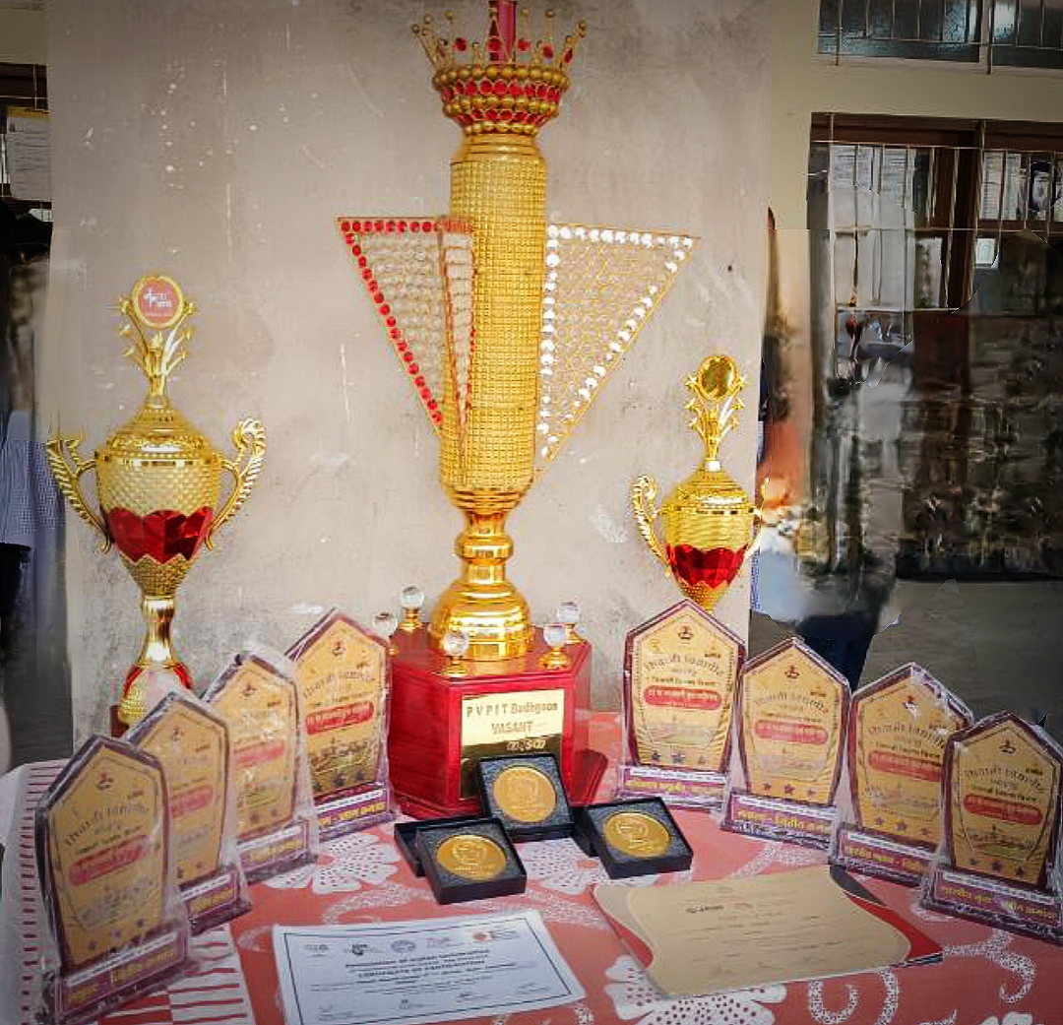
Achievements
Awards and Recognition:
Cultural Department of D.K.A.S.C.College Ichalkaranji

Slide 2
Culture department team participated and won Prize
Achievements in Cultural Events
Major Competitions and Prizes Won:
C.M. Karandak, Ichalkaranji – 20,000/-
National Level All India Dance Championship, Chiplun – 20,000/-
State Level Kamgar Kalyan Mandal –10,000/-
Youa Spandan, Ichalkaranji – 10,000/-
Vasant Karandak 2020 (Dr. P. V. P. Institute of Technology, Budhgaon) – General Championship Winner
Vibrant Dance Championship, Ghodavat University, Atigre
Pandharpur Dance Championship: Prize won
One Act Play, Atigre: 1st Prize
CSIBER College, Kolhapur: Group Dance - 2nd Place
Vasant Karandak 2019 (Dr. P. V. P. Institute of Technology, Budhgaon):Won the General Championship
National & International Achievements:
College team selected for International Level Competition in Bhutan
Won National Level General Championship at Bharat Cultural Event, Ratlam (MP).
Events Hosted and Participated
In Local and District-Level Competitions:
Kalagram Dance Competition
Shanti Niketan Folk Dance
Kolhapur District Youth Festival
Additional Cultural Wins:
Purshottam Karandak – 1st Prize
Rasvanti Karandak – 1st Prize
Participated in "Mi Honar Super Star Jallosh Danscha“
Kamal Vasant Jadhav Karandak, Mumbai – 1st Prize
Vibrant Dance Championship, Ghodavat University, Atigre: Prize won
Agricultural Exhibition, Ichalkaranji (Ministry of Agriculture, Maharashtra State): Participated and won ₹20,000/-
National Level Qawwali Competition (2018-19): One student represented Shivaji University

Slide 3
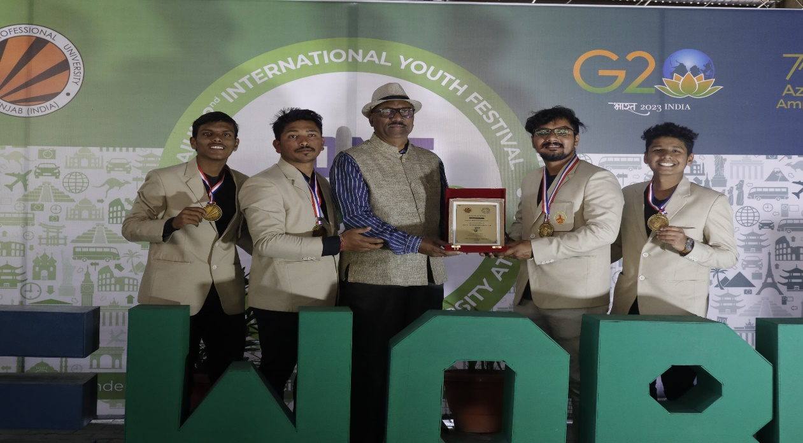
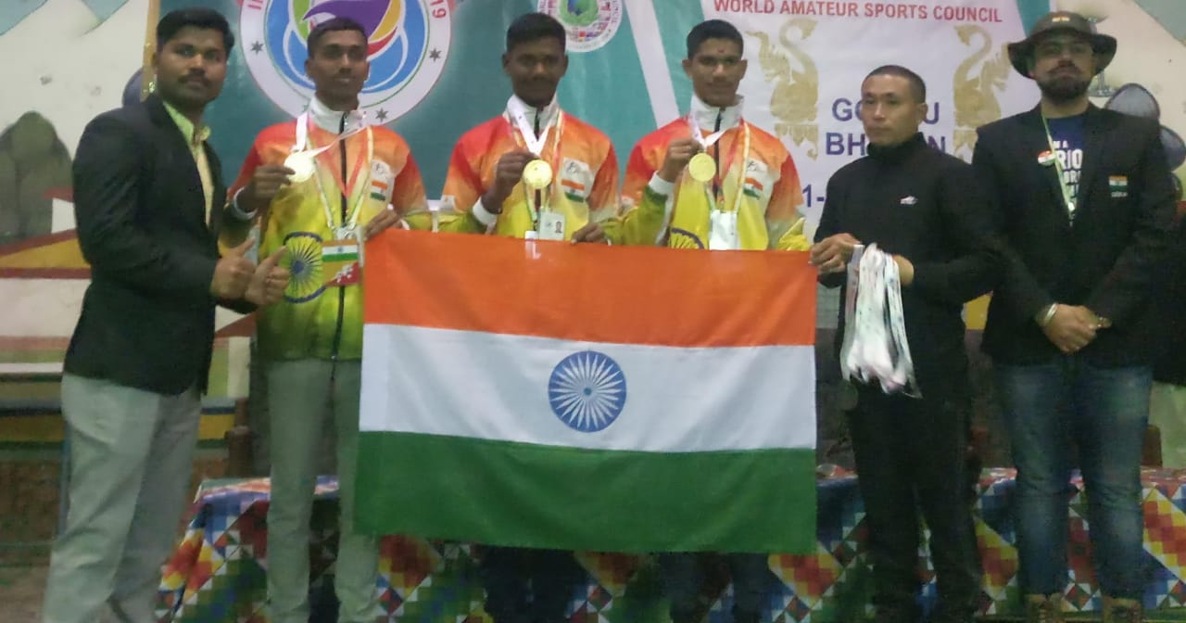
International Level
Mahesh Gavandi, Tushar Patil, Swapnil Jantre & Yashraj Patankar selected in Shivaji University team for AIU Youth Festival at Lovely Professional University, Punjab.
College team selected for International Level Competition in Bhutan.

Slide 4
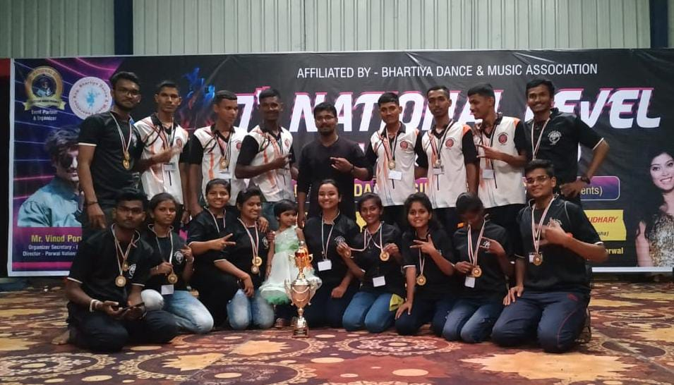
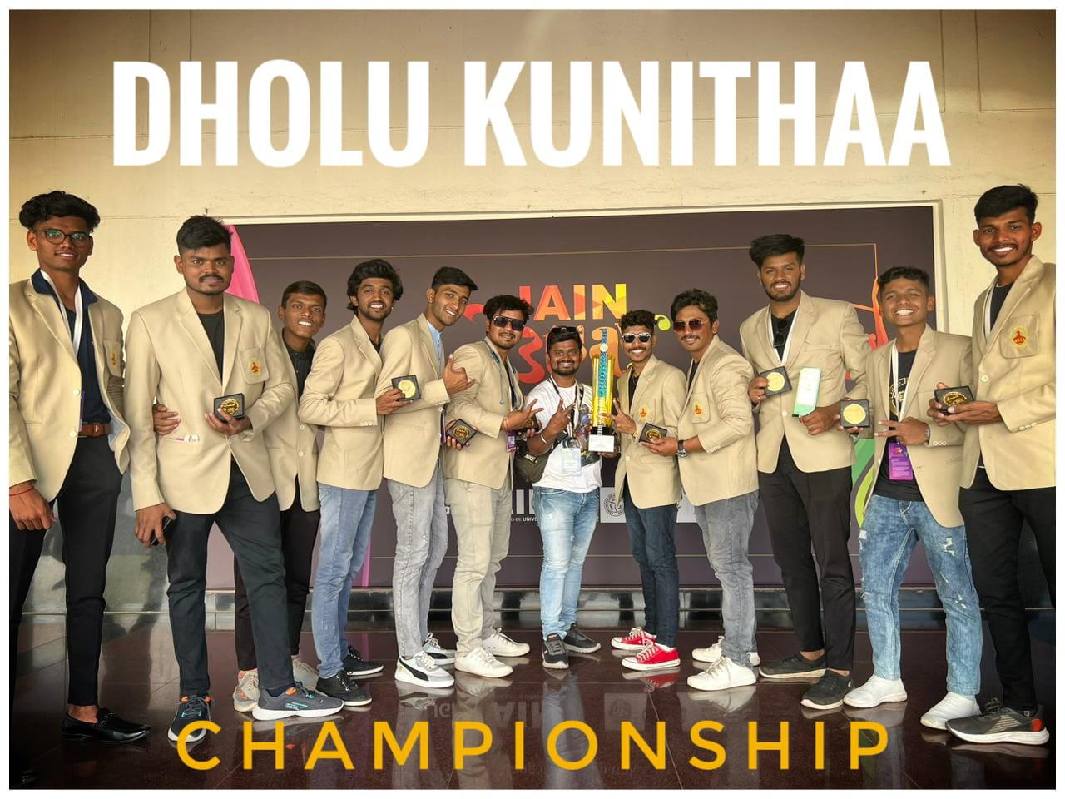
National Level
Our students selected in Shivaji University team for 36th Inter-University National Youth Festival at Jain University, Banglore.
Won National Level General Championship at Bharat Cultural Event, Ratlam (MP)

Slide 5
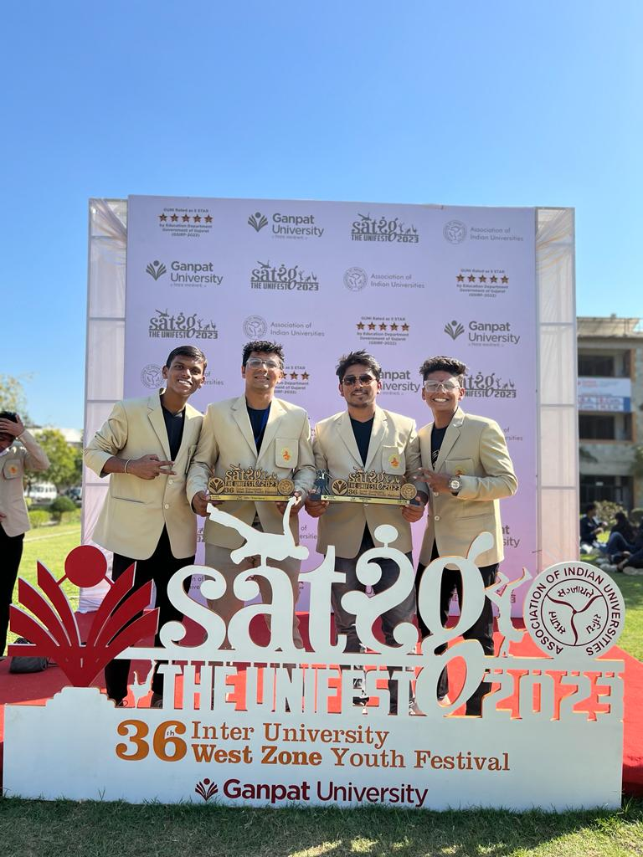
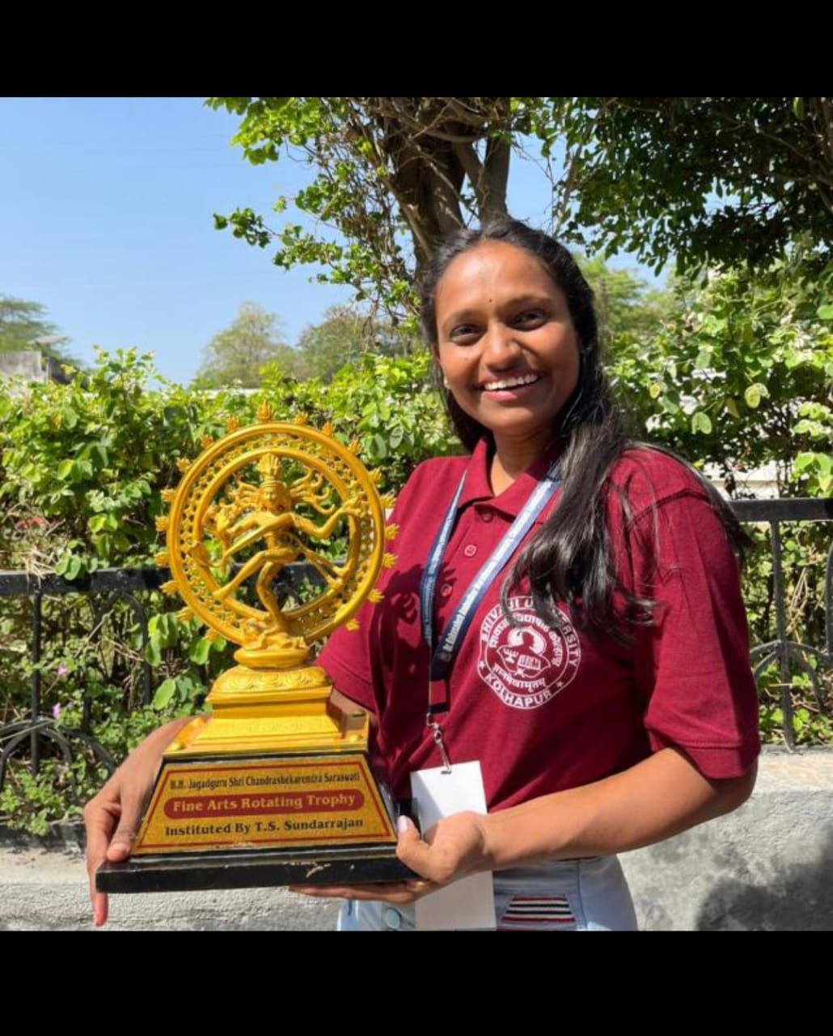
West Zone Level
Our students selected in Shivaji University team for 36th Inter-University West zone Youth festival at Ganpat University, Gujrat
Suchita Tarlekar participated in collage competition for 37th Inter-University West zone Youth festival at RTMU, Nagpur

Slide 6
2022-23
Sr. No. | Name of the award / medal | Team / Individual | Level of competition (University / State / National / International) | Nature of competition
1 | Gold Medal | Team | University (One Act Play) | Cultural Central Youth Festival
2 | Gold Medal | Individual | University (One Act Play Best Actor) | Cultural Central Youth Festival
3 | Silver Medal | Individual | University (One act Play best actor Female) | Cultural Central Youth Festival
4 | Silver Medal | Team | University (Folk Dance) | Cultural Central Youth Festival
5 | Bronz Medal | Team | University (Indian Group Song) | Cultural Central Youth Festival
6 | Consolation | Team | University (Group Installation) | Cultural Central Youth Festival
7 | Gold Medal | Individual | University (Spot Painting) | Cultural Central Youth Festival
8 | Gold Medal | Individual | University(Cartuning) | Cultural Central Youth Festival
9 | Consolation | Individual | University(Poster making) | Cultural Central Youth Festival
10 | Silver Medal | Individual | University(Clay Modeling) | Cultural Central Youth Festival
11 | General Championship | Team | University(Art section) | Cultural Central Youth Festival
12 | General Championship | Team | state | Cultural (Vasant karandak)
13 | Silver Medal | Team | State | Maharashtra Kamgar Kalyan Mandal (Folk Dance)
14 | Gold Medal | Individual | State | Vasundhara Karandak (One act Play) Best Light Management
15 | Gold Medal | Team | State | Shanti Niketan (Folk Dance)
16 | Gold Medal | Team | State | Kalagram Dance Competition
17 | Gold Medal | Team | National | 36th Inter-University National Youth Festival Association of Indian University In Delhi
18 | Best Prize | Individual | University | Cultural
19 | Medal/ Shield | Team | State | Purashottam Karandak (One Act Play)
20 | Gold Medal | Team | State | Youa Spandan Manoranjan Mandal, Icalkaranji
21 | Gold Medal | Team | State | Gaytri Mahila Mandal (Folk Dance)

Slide 7
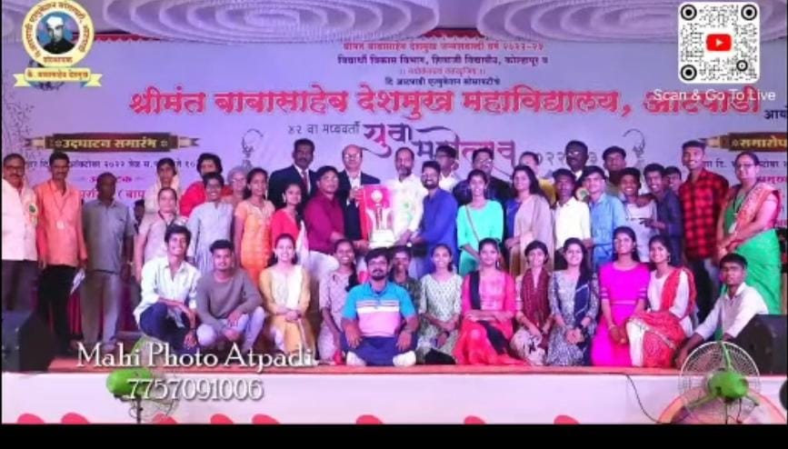
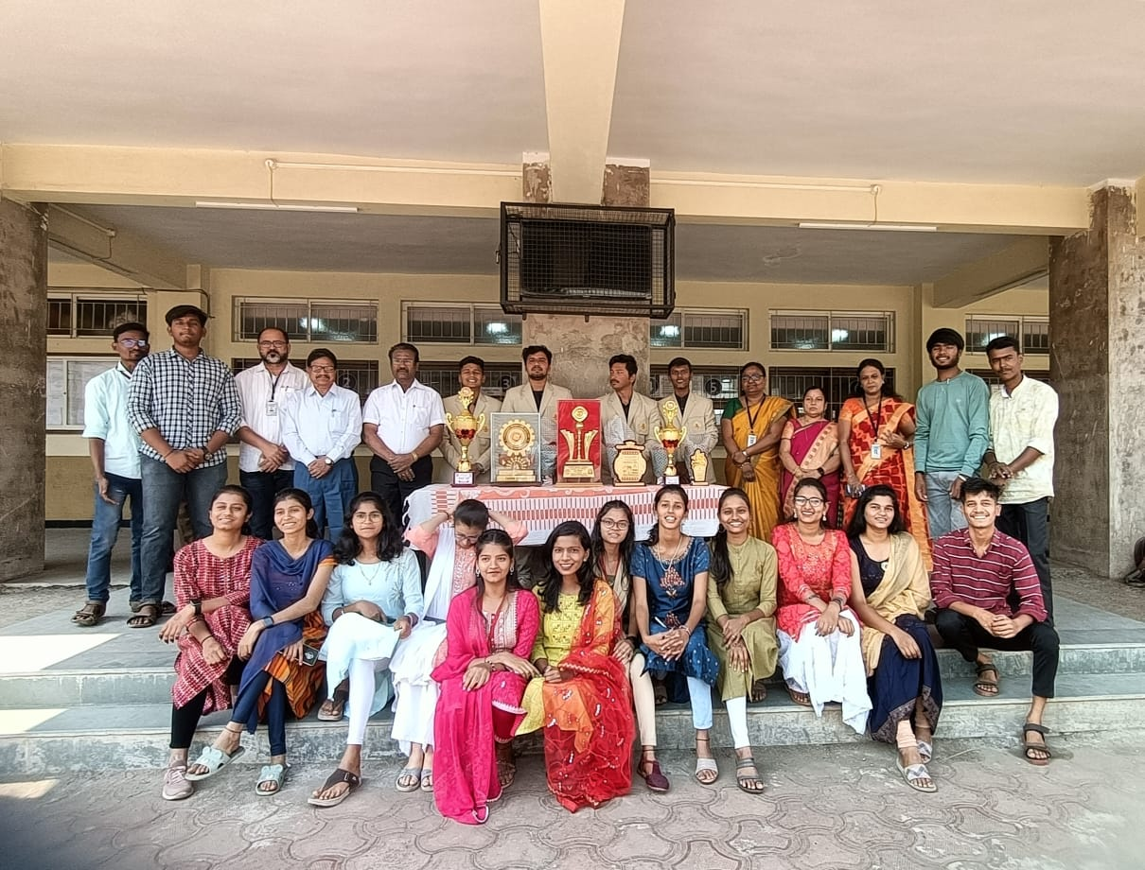
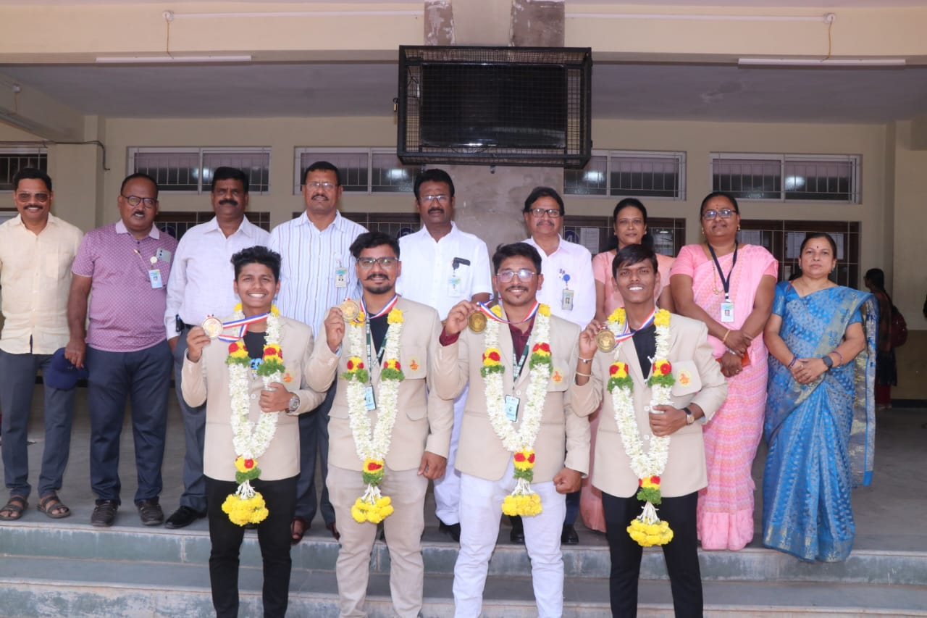
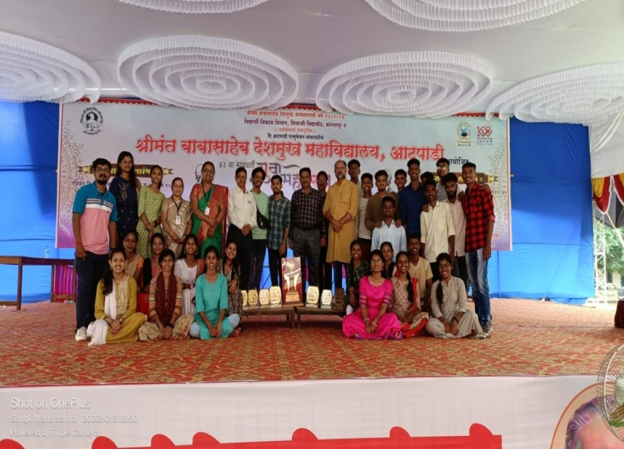
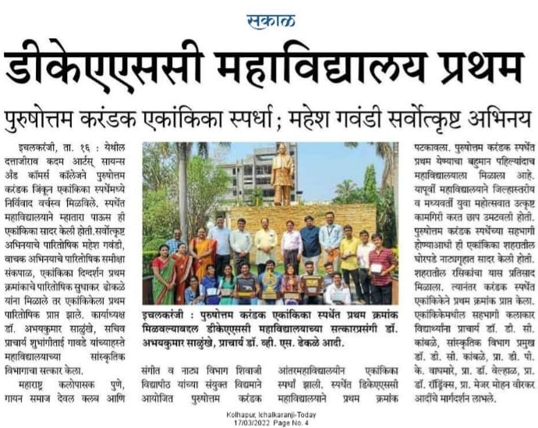
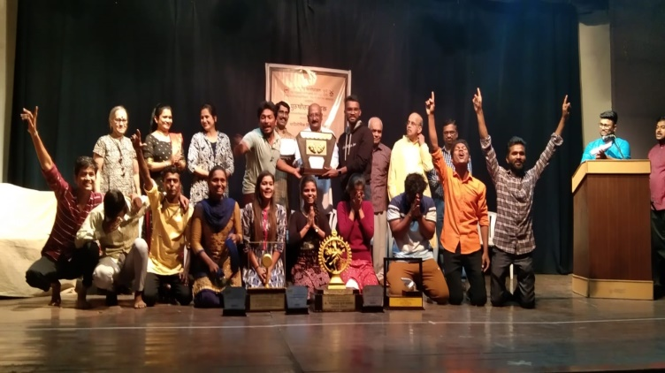
2022-23
36th Inter University West Zone Youth Festival 2022-23 (Ganpat University, Gujrat) Represent Shivaji University, Kolhapur team (Our student)
36th National and International inter university Youth Festival 2022-23 Organized by JAIN University and Lovely University, Panjab 2022-23(presented of Shivaji University, Kolhapur)
Shivaji University, Kolhapur 42nd youth festival winner team
PurushttomKarandak Winner Team 2022-23

Slide 8
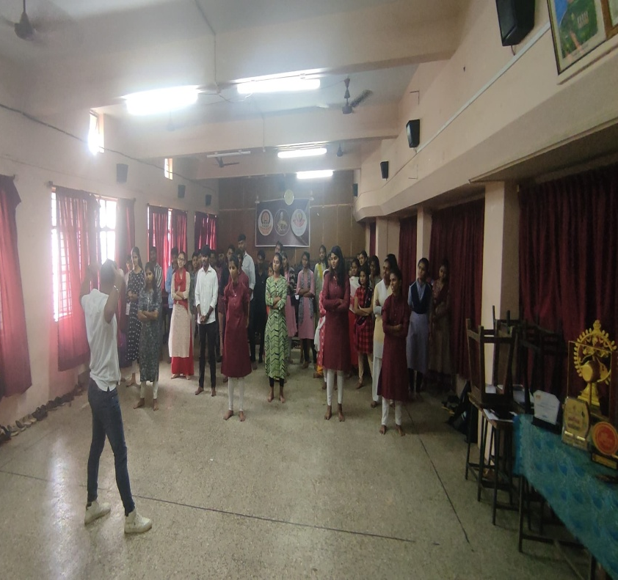
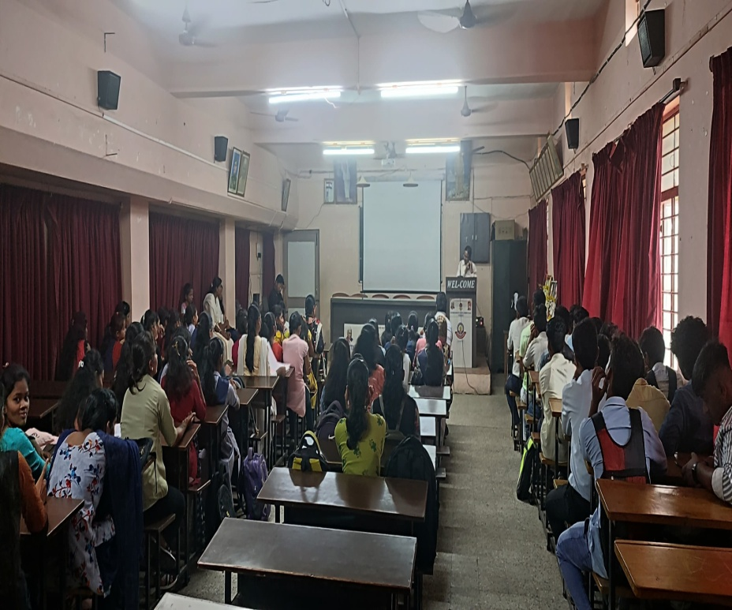
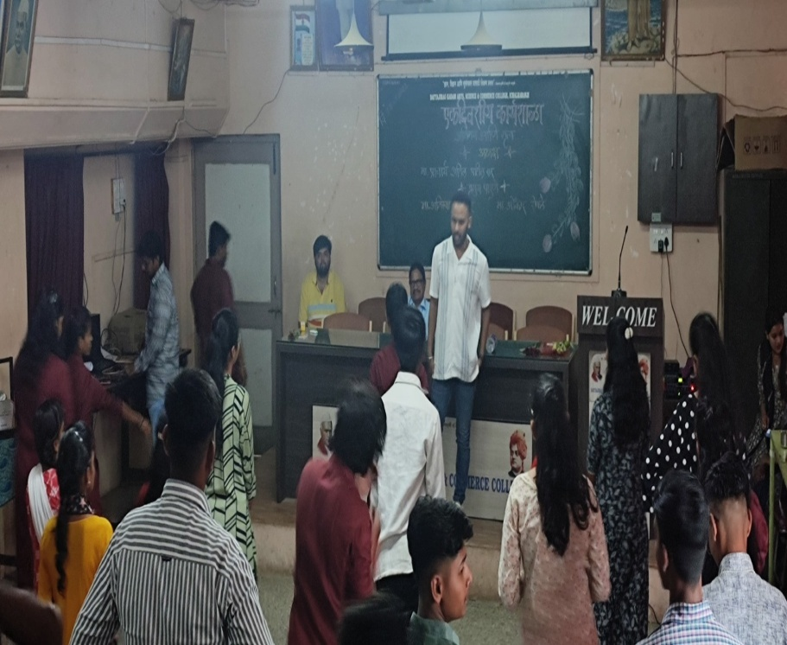
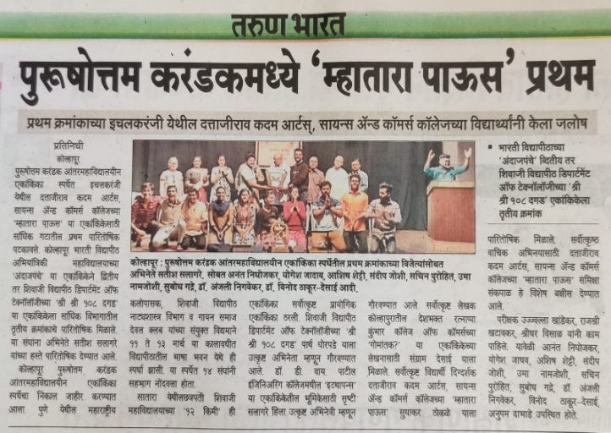
Organized Oneday workshop on Acting and Dance
Cultural Department of D.K.A.S.C .College Ichalkaranji

Slide 9
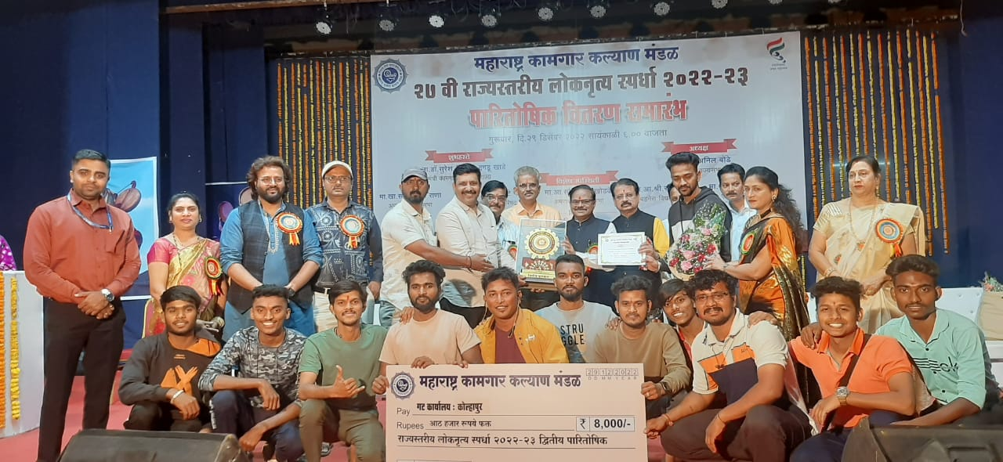
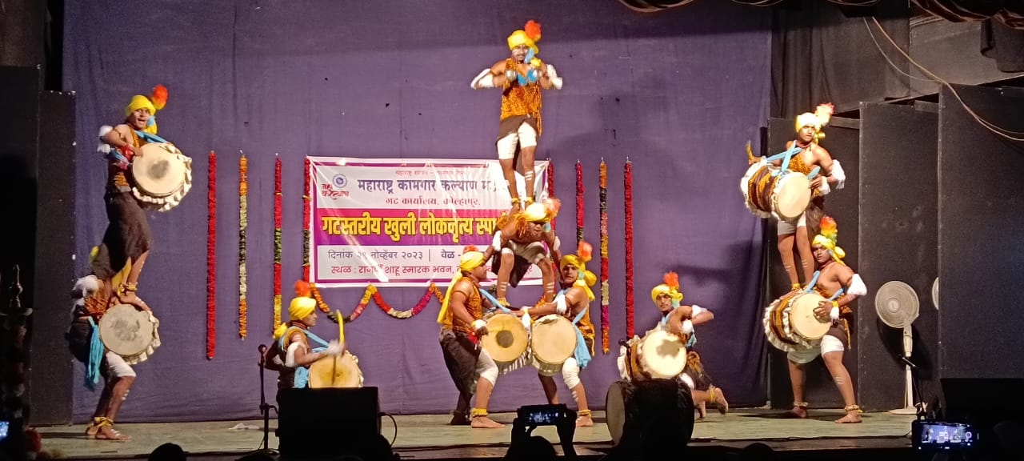
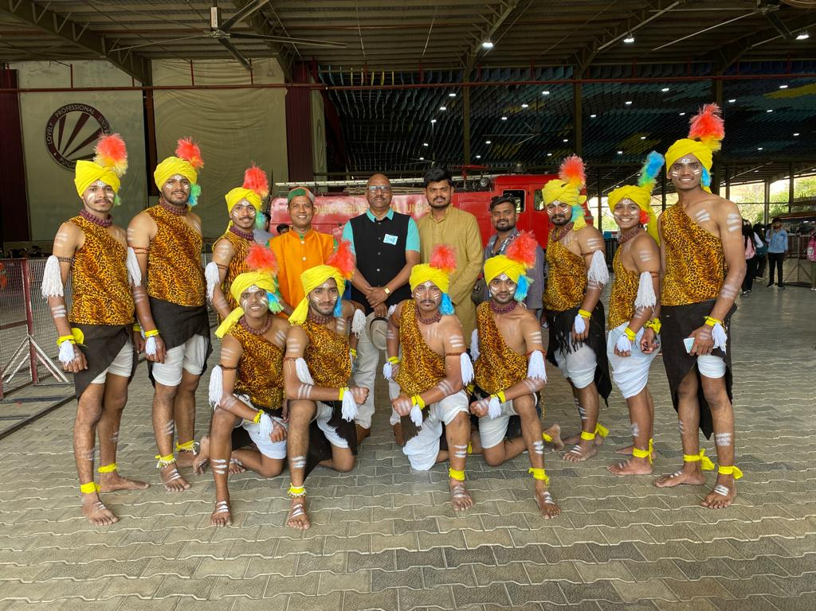
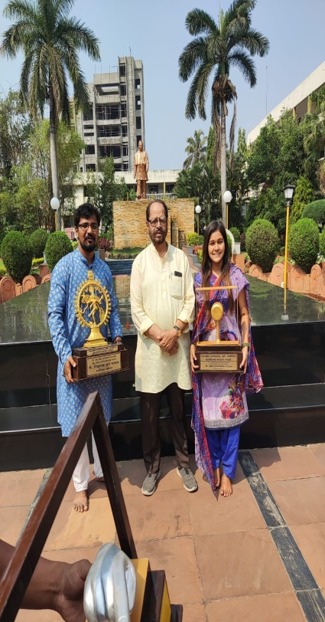
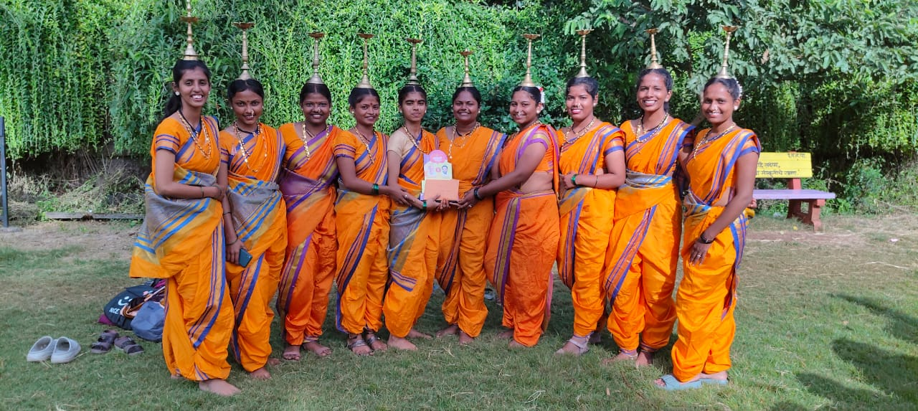
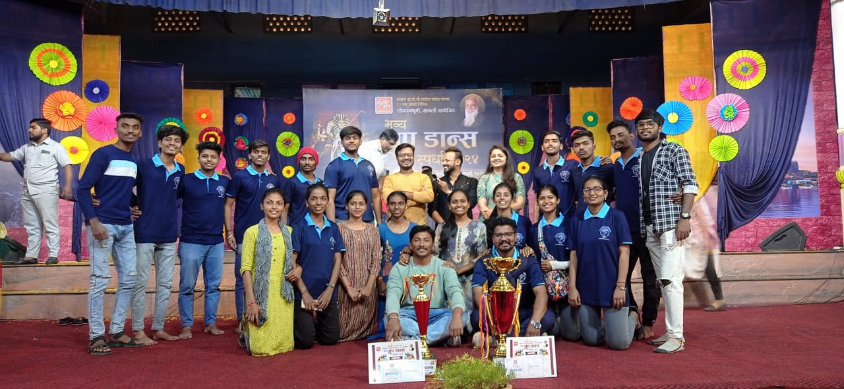
Maharashtra Kamgar kalyan Mandal Dance competition presentation and got First Prize In Dholu and Second in Divali

Slide 10
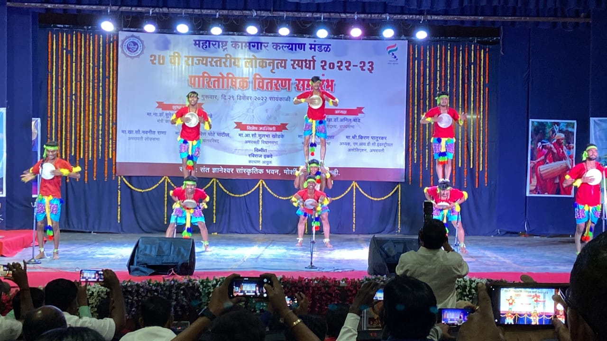

Slide 11
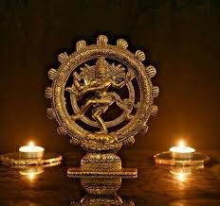
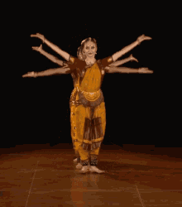
Cultural Department of D.K.A.S.C.College Ichalkaranji

