Slide 1
SHARES
Notes:
Shares

Slide 2
MEANING
The literal meaning of ‘share’ is ‘part’ or ‘portion’. But in the context of share-capital of a compan share has a different meaning .
It can be said that every part of joint capital of a company is a ‘share’, By acquiring the share of a company, any individual can become company’s shareholder.

Slide 3
CHARACTERISTICS
Movable Property
Number
Share Certificate
Registeration of Share
Right and Interest
Passive Property

Slide 4
MOVABLE PROPERTY
The share or other interest of any member if company is movable property and company is transferable in the manner provided by the article of the company .

Slide 5
2. NUMBER
Each share in the company having a share capital is ditinguished by its appropriate number.

Slide 6
3. SHARE
Every shareholder is issued a certificate under the common seal of the company certifying in the number of shares held by him . This is called share certificate .

Slide 7
4. REGISTERATION OF SHARE
The comapany maintains a register of its member in which the name, address, the number of share held, and the amount paid on each share by every holder of the company’s share is recorded .

Slide 8
5. RIGHT AND INTEREST
A shareholder of the company has certain rights and interest and, at the same time, has certain liabilities . A share is not merely an amount of money; it is a right of holder which is measured in terms of money and constitutes certain rights and obligations .

Slide 9
6. PASSIVE PROPERTY
A share is a symbol of ‘passive’ property . The ‘active’ property is in the possession of the company .

Slide 10
TYPES OF SHARES

Slide 11
EQUITY SHARES
An equity share, normally known as ordinary share is a part ownership where each member is a fractional owner and initiates the maximum entrepreneurial liability related to a trading concern . These types of shareholders in any organization possess the right to vote .

Slide 12
FEATURES OF EQUITY SHARES CAPITAL
Equity share capital remains with the company. It is given back only when the company is closed.
Equity Shareholders possess voting rights and select the company’s management.
The dividend rate on the equity capital relies upon the obtainability of the surfeit capital. However, there is no fixed rate of dividend on the equity capital.

Slide 13
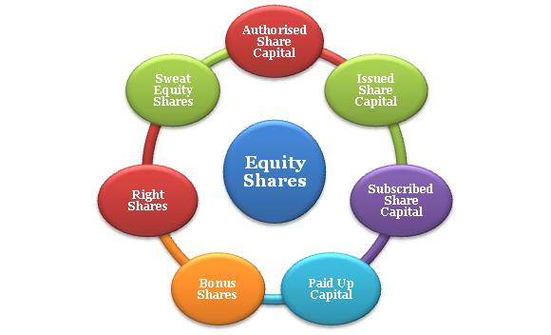
TYPES OF EQUITY SHARE

Slide 14
PREFERENCE SHARE
Preference shares, also known as preferred stock, is an exclusive share option which enables shareholders to receive dividends announced by the company before the equity shareholders.
Preference shares provide the shareholders with the special right to claim dividends during the company lifetime, and also with the option to claim repayment of capital, in case of the wind up of the company.

Slide 15
FEATURES OF PREFERENCE SHARES
Preferential dividend option for shareholders.
Preference shareholders do not have the right to vote.
Shareholders have a right to claim the assets in case of a wind up of the company.
Fixed dividend payout for shareholders, irrespective of profit earned.
Acts as a source of hybrid financing.

Slide 16
TYPES OF EQUITY SHARE

Slide 17
DIFFERENCE

Slide 18
DEFERRED SHARES
Deferred shares are also called as founder shares because these shares were normally issued to founders. The shareholders have a preferential right to get dividend before the preference shares and equity shares. No Public limited company or which is a subsidiary of a public company can issue deferred shares. This shares are issued to the founder shares to control over the management by the virtue of their voting rights.

Slide 19
STOCK
Stock is a type of investment that is done by individuals and businesses when they invest their money in business ventures in order to get a higher return on their investment. When stock is bought it means that an individual possessing that stock is possessing a part of the company whose stock was purchased.

Slide 20
CHARACTERISTICS OF STOCK
A company cannot invite the public to buy its stock.
Only fully paid up share of a company can be converted into its stock .
The stock has no definite number.
The stock-holder of a company is paid a dividend by the company.
The company’s articles must have a provision to convert share into stock.

Slide 21
CONVERSION OF SHARE INTO STOCK
When a company has received the fully paid value of its share, it can convert the amount received into it’s ‘stock’ of a company represents the value of its fully paid shares, which the company can divide into smaller parts of any amount so that the shares of a company are easily transferable. It is, therefore that each part of stock is ’share’.

Slide 22
PROCEDURE OF CONVERTING SHARE INTO STOCK
To pass a resolution in the meeting of shareholders.
Information of conversion to the registrar.
To make alteration in the articles.
To close transfer books and to inform the shareholders.
To issue stock certificate and prepare register.
Transfer of stock.

Slide 23
DIFFERENCE

Slide 24
VOTING RIGHTS OF PREFERENCE SHAREHOLDERS
As a general rule, the holder of preference share have no voting right; but, in the following situtations
Issue related to their interest
Non payment of Dividend

Slide 25
VOTING RIGHTS OF EQUITY SHAREHOLDER
Every equity shareholder has right to vote on every resolution placed before the company at any meeting. Also the voting right of every equity shareholder is proportionate to his contribution to paid-up capital of the company.

