Slide 1
DATTAJIRAO KADAM ARTS, SCIENCE AND COMMERCE COLLEGE, ICHALKARANJI Department of Physics Bachelor of Science part Iii Paper-XI: DSE-E3, Classical Mechanics and Classical Electrodynamics MOTION OF A RIGID BODY IN SPACE

Slide 2
RIGID BODY:
“A rigid body is a solid body in which deformation is zero or so small it can be neglected. The distance between any two given points on a rigid body remains constant in time regardless of external forces or moments exerted on it. A rigid body is usually considered as a continuous distribution of mass.”
Rigid body
Non-Rigid body

Slide 3
CHARACTERISTICS OF RIGID BODY MOTION
All lines on a rigid body have the same angular velocity and the same angular acceleration.
Rigid motion can be decomposed into the translation of an arbitrary point, followed by a rotation about the point.

Slide 4
EULER’S DYNAMICAL EQUATIONS

Slide 5
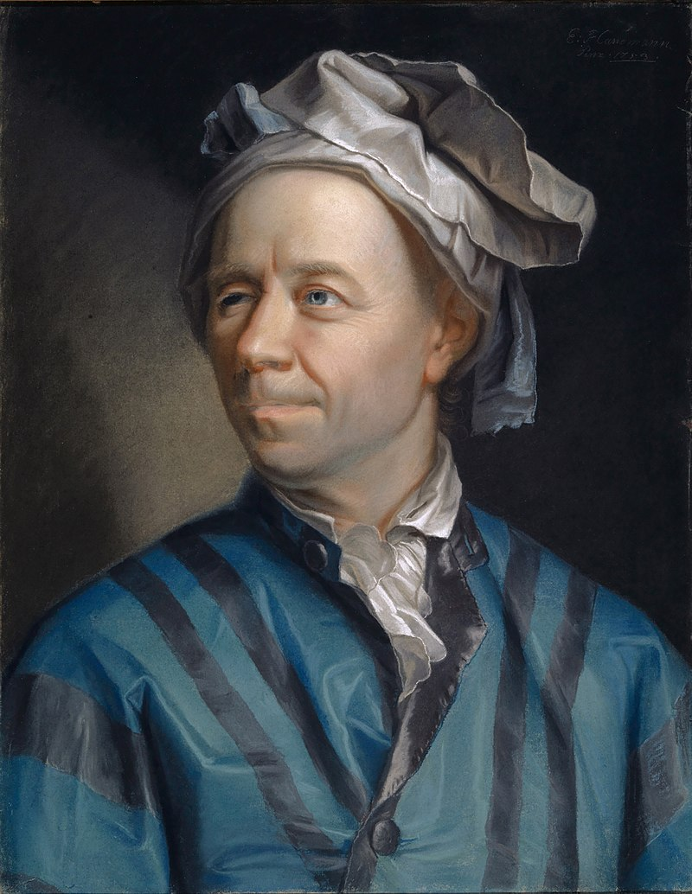
Leonhard Euler
Leonhard Euler15 April 1707 – 18 September 1783) was a Swiss mathematician, physicist, astronomer, geographer, logician and engineer who made important and influential discoveries in many branches of mathematics.
Amongst his many discoveries and developments, Euler is credited for introducing the Greek letter pi.

Slide 6
Let the rigid body be rotating with angular velocity $\vec{ω}$ about a point O fixed both in space and in the body. Let OX, OY, OZ be principal axes at O. If L, $\left[I_{ij}\right], \vec{ω}$ be angular momentum, M.I. matrix and angular velocity at O, then
$$\left[L\right]=\left[I\right][\vec{ω}]$$
$$\left[L\right]=\left[I_{ij}\right][\vec{ω}]$$
$$\left[\begin{matrix}L_{x} \\ L_{y} \\ L_{z}\end{matrix}\right]=\left[\begin{matrix}I_{xx} & I_{xy} & I_{xz} \\ I_{xy} & I_{yy} & I_{yz} \\ I_{xz} & I_{yz} & I_{zz}\end{matrix}\right]\left[\begin{matrix}ω_{x} \\ ω_{y} \\ ω_{z}\end{matrix}\right]$$
$∵$ the axes OX, OY, OZ are principal axes,

Slide 7
${ I}_{xy}=I_{xz}=I_{yz}=0$
$∵$so the product of inertia about these axis will be zero
$∴$we can write
$$\left[\begin{matrix}L_{x} \\ L_{y} \\ L_{z}\end{matrix}\right]=\left[\begin{matrix}I_{xx} & 0 & 0 \\ 0 & I_{yy} & 0 \\ 0 & 0 & I_{zz}\end{matrix}\right]\left[\begin{matrix}ω_{x} \\ ω_{y} \\ ω_{z}\end{matrix}\right]=\left[\begin{matrix}ω_{x}I_{xx} \\ ω_{y}I_{yy} \\ ω_{z}I_{zz}\end{matrix}\right]$$
Or
$$L= ω_{x}I_{x}\underline{i}+ω_{y}I_{y}\underline{j}+ω_{z}I_{z}\underline{k}$$
$$= ω_{1}I_{1}\underline{i}+ω_{2}I_{2}\underline{j}+ω_{3}I_{3}\underline{k}$$
where $I_{1}, I_{2}, I_{3}$ are principal moments

Slide 8
Now the rate of change of any vector function F in fixed and rotating coordinate systems is related by
$${\left(\frac{dF}{dt}\right)}_{f}= {\left(\frac{dF}{dt}\right)}_{r}+ \vec{ω}×F$$
$${\left(\frac{dL}{dt}\right)}_{f}= {\left(\frac{dL}{dt}\right)}_{r}+ \vec{ω}×L$$
$$= \frac{d}{dt}\left(I_{1}ω_{1}\underline{i}+I_{2}ω_{2}\underline{j}+I_{3}ω_{3}\underline{k}\right)+\vec{ω}×L$$
$$= I_{1}\dot{ω_{1}}\underline{i}+I_{2}\dot{ω_{2}}\underline{j}+I_{3}\dot{ω_{3}}\underline{k}+\vec{ω}×L$$
Where the symbols on the R.H.S refer to the rotating coordinate system. But $\frac{dL}{dt}=G$, the total external torque (in the fixed or inertial coordinate system).
$∵$Replace F by L
$∵$ in rotating, only derivative $ω$ , in fixed derivative L.

Slide 9
Therefore on the substitution,
G$= I_{1}\dot{ω_{1}}\underline{i}+I_{2}\dot{ω_{2}}\underline{j}+I_{3}\dot{ω_{3}}\underline{k}+\vec{ω}×L$
$G_{x}\underline{i}+G_{y}\underline{j}+G_{z}\underline{k}=$ $I_{1}\dot{ω_{1}}\underline{i}+I_{2}\dot{ω_{2}}\underline{j}+I_{3}\dot{ω_{3}}\underline{k}+\left|\begin{matrix}i & j & k \\ ω_{x}^{1} & ω_{y}^{2} & ω_{z}^{3} \\ L_{1} & L_{2} & L_{3}\end{matrix}\right|$
$G_{x}\underline{i}+G_{y}\underline{j}+G_{z}\underline{k}=$ $I_{1}\dot{ω_{1}}\underline{i}+I_{2}\dot{ω_{2}}\underline{j}+I_{3}\dot{ω_{3}}\underline{k}+\underline{i}\left(ω_{2}L_{3}−ω_{3}L_{2}\right)+\underline{j}\left(ω_{3}L_{1}−ω_{1}L_{3}\right)+\underline{k}(ω_{1}L_{2}−L_{1}ω_{2})$
This vector equation is equivalent to the following three scalar equations:
On comparing
$$G_{x}=I_{1}\dot{ω_{1}}+ω_{2}L_{3}−ω_{3}L_{2}$$
$$G_{y}=I_{2}\dot{ω_{2}}+ω_{3}L_{1}−ω_{1}L_{3}$$
$$G_{z}=I_{3}\dot{ω_{3}}+ω_{1}L_{2}−ω_{2}L_{1}$$
---------1

Slide 10
Now using the results $L_{1}=ω_{1}I_{1}, L_{2}=ω_{2}I_{2}, L_{3}=ω_{3}I_{3}$ which are true w.r.t. principal axes,
we have
$$G_{x}=I_{1}\dot{ω_{1}}−(I_{2}−I_{3})ω_{2}ω_{3}$$
$$G_{y}=I_{2}\dot{ω_{2}}−(I_{3}−I_{1})ω_{1}ω_{3}$$
$$G_{z}=I_{3}\dot{ω_{3}}−{(I}_{1}−I_{2})ω_{2}ω_{1}$$
These equations are called Euler’s Dynamical Equations.
They describe the motion of a rigid body fixed at a point.

Slide 11
DEDUCTIONS FROM EULER’S EQUATIONS

Slide 12
We will discuss some results which follow directly from the Euler dynamical equations.
In the absence of external forces, G=0, and the Euler equations (1) reduce to
$$\frac{dL}{dt}=0⇒L=constant$$
$I_{1}\dot{ω_{1}}−\left(I_{2}−I_{3}\right)ω_{2}ω_{3}=0$ ----- 1
$I_{2}\dot{ω_{2}}−\left(I_{3}−I_{1}\right)ω_{1}ω_{3}=0$ ----- 2
$I_{3}\dot{ω_{3}}−{(I}_{1}−I_{2})ω_{2}ω_{1}=0$ ----- 3
Multiply 1,2,3 by $ω_{1}, ω_{2}, ω_{3}$ respectively and adding, we have
$$I_{1}ω_{1}\dot{ω_{1}}+I_{2}ω_{2}\dot{ω_{2}}+I_{3}ω_{3}\dot{ω_{3}=0}$$

Slide 13
$$\frac{1}{2}\frac{d}{dt}\left(I_{1}ω_{1}^{2}+I_{2}ω_{2}^{2}+I_{3}ω_{3}^{2}\right)=0$$
Or $I_{1}ω_{1}^{2}+I_{2}ω_{2}^{2}+I_{3}ω_{3}^{2}=constant$
Now for the kinetic of a rigid body we have the relation $T=\left(1/2\right)\vec{ω}.L$ which when referred to the principal axes reduces to $T=\left(1/2\right)\left(I_{1}ω_{1}^{2}+I_{2}ω_{2}^{2}+I_{3}ω_{3}^{2}\right).$
In view of this formula we find that in this case T=constant, i.e., the kinetic energy in the absence of external forces is a constant of motion.
This is so because no work is being done by the external forces, and therefore the potential energy is a constant.

Slide 14
Another integral of the force-free equations can be obtained by multiplying 1, 2, 3 by $I_{1}ω_{1}, I_{2}ω_{2}, I_{3}ω_{3}$ respectively and adding. We get
$$I_{1}^{2}ω_{1}\dot{ω_{1}}+I_{2}^{2}ω_{2}\dot{ω_{2}}+I_{3}^{2}ω_{3}\dot{ω_{3}=0}$$
Or $\frac{d}{dt}{(I}_{1}^{2}ω_{1}^{2}+I_{2}^{2}ω_{2}^{2}+I_{3}^{2}ω_{3}^{2})=0$
Or $I_{1}^{2}ω_{1}^{2}+I_{2}^{2}ω_{2}^{2}+I_{3}^{2}ω_{3}^{2}=constant$ ------4
Now the angular momentum L w.r.t. the triad of principal axes is given by
$${L=I}_{1}ω_{1}\underline{i}+I_{2}ω_{2}\underline{j}+I_{3}ω_{3}\underline{k}$$
And therefore $L^{2}={\left|L\right|}^{2}=I_{1}^{2}ω_{1}^{2}+I_{2}^{2}ω_{2}^{2}+I_{3}^{2}ω_{3}^{2}$
Hence eq.4 expresses the fact that the magnitude of L is a constant of motion.
This can be related to the absence of the external torque about the point O.

Slide 15
GENERAL MOTION
OF A
RIGID BODY

Slide 16
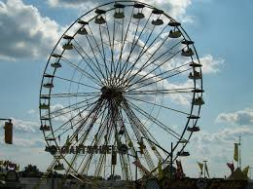
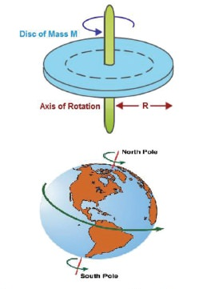
General Motion = Translational Motion + Rotational Motion
TRANSLATIONAL MOTION
“The motion by which a body shifts from one point in space to another.” Or
“A body moves along a line without any rotation. The line may be straight or curved.”
Example: A bullet fired from a gun, Ferris wheel etc.
ROTATIONAL MOTION
“ A kind of motion in which the body follows a curved path.”
“The spinning motion of a body about its axis”
Example, the wheel of the car , Earth etc.

Slide 17
In the general motion of a body (i.e., no point of the body is fixed in space).
Let $F_{c}^{ext}$ be the total external force on the rigid body and $G_{c}^{ext}$ the total external torque about is mass centre (i.e., centroid).
Then the equations of motion are
$$Ma_{c}=F_{c}^{ext}$$
$$\dot{L_{c}}=G_{c}$$
Where $a_{c}$ is the acceleration of the centre mass and $L_{c}$ is the total angular momentum about it. Now we resolve the vectors $a_{c}$, F, $G_{c}$ and L along the unit vector $i, j, k$ taken along the principal axes at the mass centre. The triad of vectors $i, j, k$ may be referred to as a principal triad. It will be assumed to be permanently a principal triad. Let $\vec{Ω}$ be the angular velocity. If the triad is fixed in the body then $\vec{Ω}= \vec{ω}$, the angular velocity of the body. Now using the relation
$${\left(\frac{dF}{dt}\right)}_{f}= {\left(\frac{dF}{dt}\right)}_{r}+ \vec{ω}×F$$
$$F=ma$$
------------ (1)
$$Torque =G=\dot{L}$$
------------ (2)

Slide 18
Which relates the rate of change of a vector in a fixed (i.e., inertial) frame and a rotating frame, we have (on dropping the suffix r)
$$a_{f}= {\left(\frac{dv}{dt}\right)}_{f}=\frac{dv}{dt}+ \vec{Ω} ×ν$$
$$a_{f}= \frac{dv}{dt}+ \vec{Ω} ×ν$$
Where $v=v_{1}i+v_{2}j+v_{3}k$ is the velocity of the mass centre (in the rotating coordinate system).
F = v
$$ν_{f}= ν_{r}=ν$$
------------ (3)

Slide 19
Substituting for $a_{f}=a_{c}$form (3) into (1), we obtain
$$Ma_{c}=F_{c}^{ext}$$
$$M\left(\frac{dv}{dt}+ \vec{Ω} ×ν \right)=F$$
$$M\left[\left(\dot{ν_{1}}i+ \dot{ν_{2}}j+ \dot{ν_{3}}k\right)+ \left|\begin{matrix}i \\ Ω_{1} \\ ν_{1}\end{matrix} \begin{matrix}j \\ Ω_{2} \\ ν_{2}\end{matrix} \begin{matrix}k \\ Ω_{3} \\ ν_{3}\end{matrix}\right|\right]= F_{1}i+ F_{2}j+ F_{3}k$$
$$M\left[\left(\dot{ν_{1}}i+ \dot{ν_{2}}j+ \dot{ν_{3}}k\right)+ i\left(Ω_{2} ν_{3}−Ω_{3} ν_{2}\right)−j \left(Ω_{1} ν_{3}− Ω_{3} ν_{1}\right)+k \left(Ω_{1} ν_{2}− Ω_{2} ν_{1} \right)\right]= F_{1}i+ F_{2}j+ F_{3}k$$
$$M\left[\left(\dot{ν_{1}}i + i\left(Ω_{2} ν_{3}−Ω_{3} ν_{2}\right)\right)+ \left(\dot{ν_{2}}j −j \left(Ω_{1} ν_{3}− Ω_{3} ν_{1}\right)\right)+ \left(\dot{ν_{3}}k +k \left(Ω_{1} ν_{2}− Ω_{2} ν_{1} \right)\right) \right]= F_{1}i+ F_{2}j+ F_{3}k$$

Slide 20
Which is equivalent to
$$M \left(\dot{ν_{1}} + Ω_{2} ν_{3}−Ω_{3} ν_{2}\right)= F_{1}$$
$$M \left(\dot{ν_{2}} + Ω_{3} ν_{1}−Ω_{1} ν_{3}\right)= F_{2}$$
$$M \left(\dot{ν_{3}} + Ω_{1} ν_{2}− Ω_{2} ν_{1}\right)= F_{3}$$
From 2, on using
$${\left(\frac{dL}{dt}\right)}_{f}= \frac{dL}{dt}+ Ω×L$$
$${\left(\frac{dL}{dt}\right)}_{f}= \left(I_{1}\dot{ω_{1}} i+ I_{2}\dot{ω_{2}} j+ I_{3}\dot{ω_{3}} k\right)+ \left|\begin{matrix}i \\ Ω_{1} \\ L_{1}\end{matrix} \begin{matrix}j \\ Ω_{2} \\ L_{2}\end{matrix} \begin{matrix}k \\ Ω_{3} \\ L_{3}\end{matrix}\right|$$
And the relation $L= I_{1}\dot{ω_{1}} i+ I_{2}\dot{ω_{2}} j+ I_{3}\dot{ω_{3}} k$, we obtain the equation
------------ (4)
$$∴ \dot{L_{c}}=G_{c}$$

Slide 21
$${\left(\frac{dL}{dt}\right)}_{f}=I_{1}\dot{ω_{1}} i+I_{2}\dot{ω_{2}} j+I_{3}\dot{ω_{3}} k+\left(Ω_{2} L_{3}−Ω_{3} L_{2}\right) i−\left(Ω_{1} L_{3}−Ω_{3} L_{1}\right) j+\left(Ω_{1} L_{2}−Ω_{2} L_{1}\right) k=G$$
$$I_{1}\dot{ω_{1}} i+ I_{2}\dot{ω_{2}} j+ I_{3}\dot{ω_{3}} k+\left(Ω_{2} L_{3}−Ω_{3} L_{2}\right) i− \left(Ω_{1} L_{3}−Ω_{3} L_{1}\right) j+ \left(Ω_{1} L_{2}−Ω_{2} L_{1}\right) k= G_{1}i+ G_{2}j+ G_{3}k$$
From this vector equation we obtain the following three scalar equations
$$I_{1}\dot{ω_{1}}+ Ω_{2} L_{3}−Ω_{3} L_{2}=G_{1}$$
$$I_{2}\dot{ω_{2}}+ Ω_{3} L_{1}−Ω_{1} L_{3}= G_{2}$$
$$I_{3}\dot{ω_{3}}+ Ω_{1} L_{2}−Ω_{2} L_{1}= G_{3}$$
Where we have used the results
$$L_{1}= I_{1}ω_{1}, L_{2}= I_{2}ω_{2}, L_{3}= I_{3}ω_{3}$$

Slide 22
We have
$$I_{1}\dot{ω_{1}}+ Ω_{2} I_{3}ω_{3}−Ω_{3} I_{2}ω_{2}=G_{1}$$
$$I_{2}\dot{ω_{2}}+ Ω_{3} I_{1}ω_{1}−Ω_{1} I_{3}ω_{3}= G_{2}$$
$$I_{3}\dot{ω_{3}}+ Ω_{1} I_{2}ω_{2}−Ω_{2} I_{1}ω_{1}= G_{3}$$
Which are the same as for a rigid body with a fixed point.
In these equations $I_{1}, I_{2}, I_{3}$ denote principal moments of inertia at the centroid of the body.
The set of equations 4 and 5 constitute six equations for the components of velocity of the mass centre and the components of angular velocity of the body.
------------ (5)

Slide 23
For any these six equations, we can substitute the law of conservation of energy, viz.
$T+V=E$
provided the external forces are conservative.
The last equation is equivalent to
$$\frac{1}{2} M \left({v_{1}}^{2}+ {v_{2}}^{2}+ {v_{3}}^{2}\right)+ \frac{1}{2} \left(I_{1}{ω_{1}}^{2}+ I_{2}{ω_{2}}^{2}+ I_{3}{ω_{3}}^{2}\right)+V=E$$
K.E + P.E = Total Energy
$$Conservative ⇒F=0$$
$$T=T_{tr}+ T_{rot}$$
$T=$ $\frac{1}{2}Mv^{2}+\frac{1}{2}\vec{ω}.L$

Slide 24
ANY QUESTION

