Slide 1
DATTAJIRAO KADAM ARTS, SCIENCE AND COMMERCE COLLEGE, ICHALKARANJI
Department of Physics Bachelor of Science part III
Paper-XVI: DSE-F4, Energy Studies and Material Science SOLAR ENERGY

Slide 2
Solar Energy
Solar energy, a renewable and abundant resource with the potential to transform our energy landscape.

Slide 3
Understanding the Solar Spectrum
Electromagnetic Radiation
Visible Light Spectrum
Infrared and Ultraviolet
The sun emits a spectrum of electromagnetic radiation, encompassing various wavelengths.
Visible light, a small portion of the spectrum, is what we see as colors.
Infrared radiation provides heat, while ultraviolet radiation is responsible for sunburns.

Slide 4
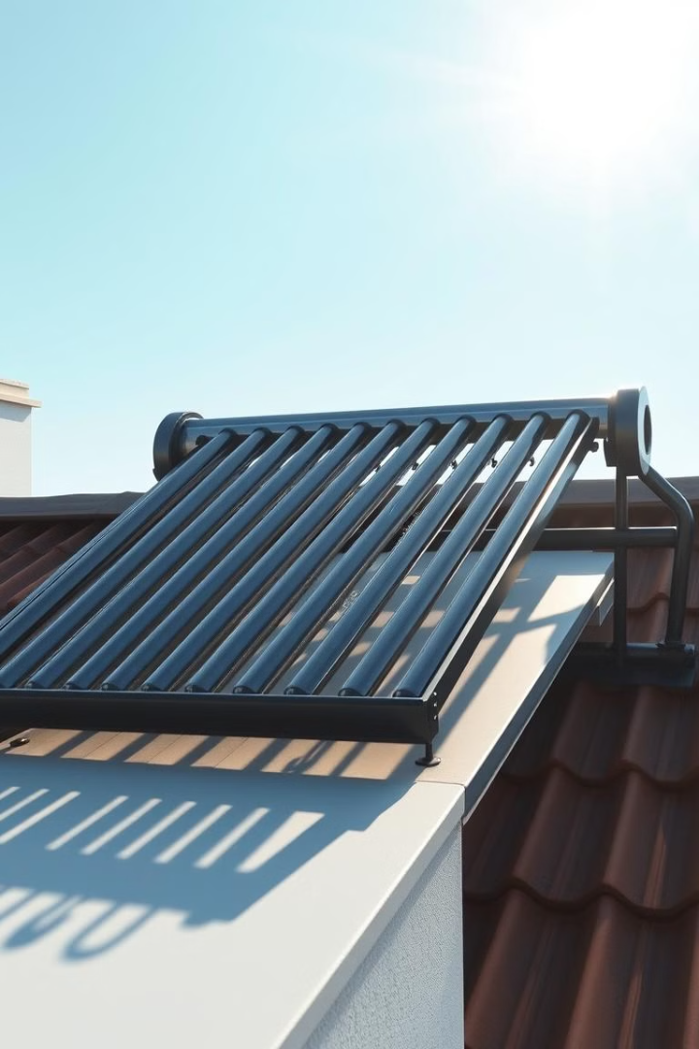
Thermal Utilization of Solar Energy
1
Harnessing Heat
2
Solar Water Heating
This approach uses sunlight to generate heat for various applications.
Heating water for residential and commercial purposes using solar energy.
3
Solar Cooking
Utilizing solar concentrators to reach temperatures high enough for cooking.

Slide 5
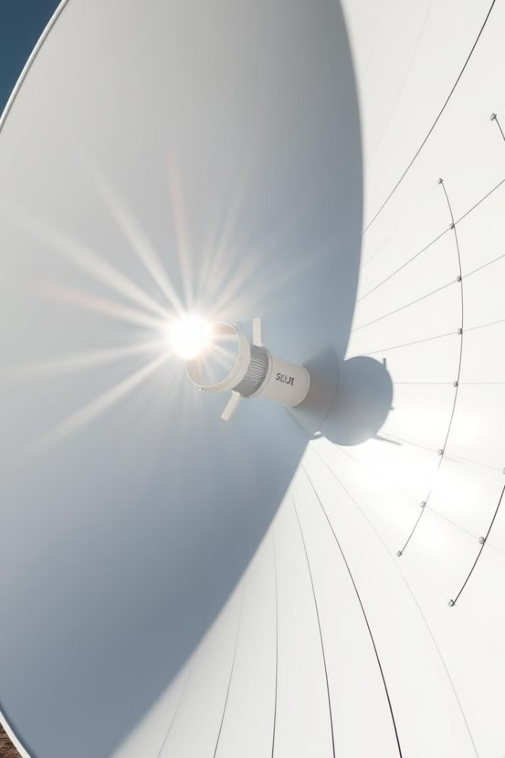
Solar Thermal Technologies
Flat-Plate Collectors
Evacuated Tube Collectors
These collectors absorb solar radiation and transfer heat to a working fluid.
Similar to flat-plate collectors, but with improved insulation and higher efficiency.
Parabolic Trough Collectors
Use parabolic mirrors to concentrate sunlight and heat a fluid to high temperatures.

Slide 6
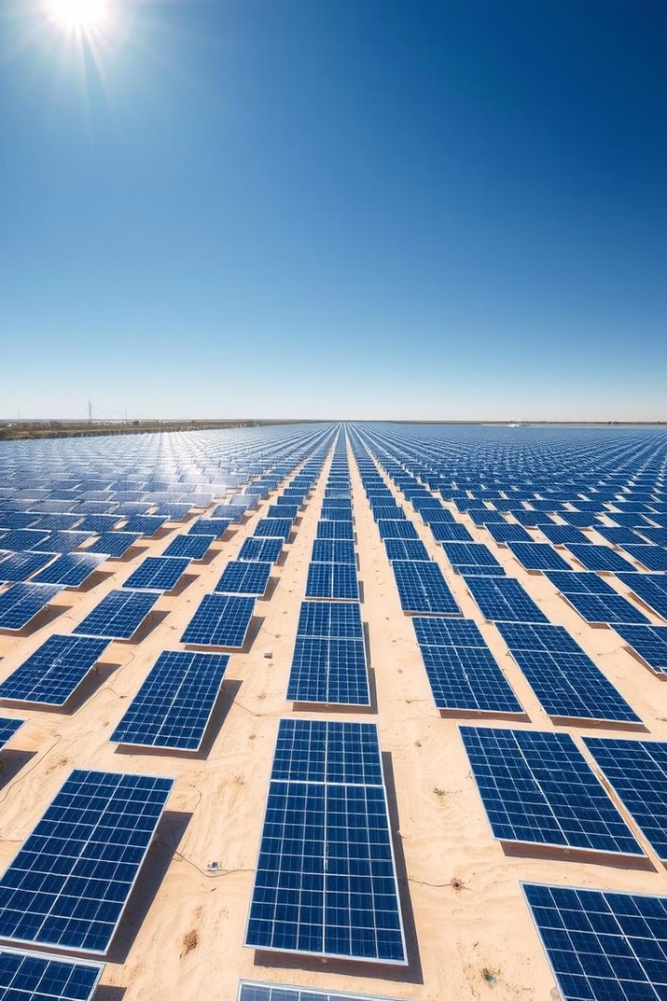
Photovoltaic Utilization of Solar Energy
Sunlight to Electricity
Solar photovoltaic (PV) technology converts sunlight directly into electricity.
Photovoltaic Effect
This effect occurs when photons from sunlight strike a semiconductor material.
Residential and Commercial Applications
Solar PV systems are widely used for generating electricity in homes and businesses.

Slide 7
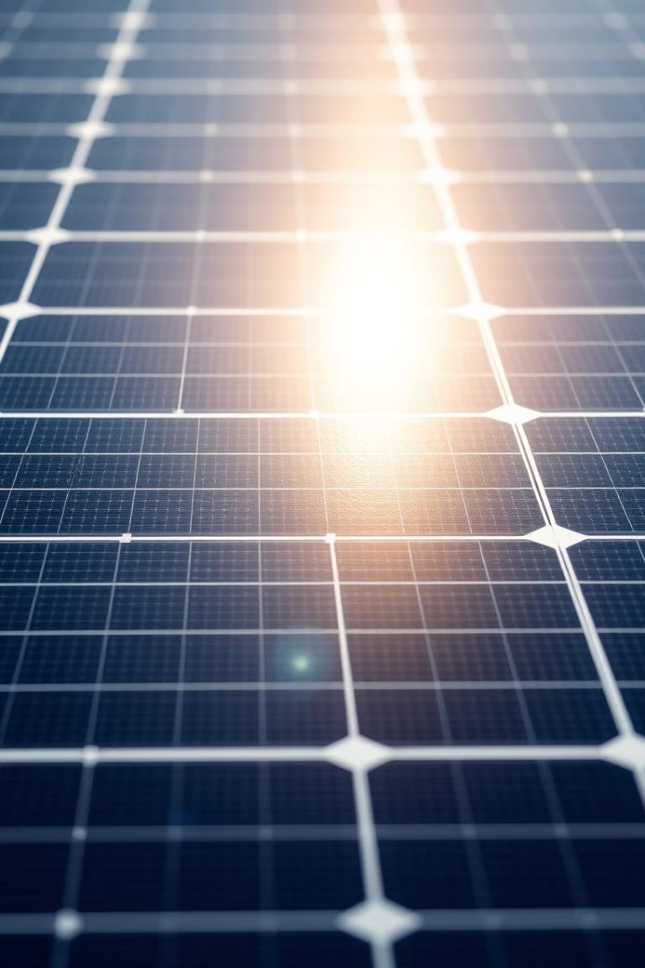
Solar Photovoltaic Technologies
1
Crystalline Silicon
The most common type of PV technology, using silicon crystals to generate electricity.
2
Thin-Film Solar Cells
Uses thin layers of semiconductor materials, offering lower cost and flexibility.
3
Organic Photovoltaics
Utilizes organic materials to generate electricity, offering potential for lower-cost manufacturing.

Slide 8
Comparison of Thermal and Photovoltaic Approaches
Thermal
1
Heat production.
2
Applications
Water heating, cooking.
3
Technologies
Flat-plate collectors, parabolic troughs.
4
Photovoltaic
Electricity generation.
5
Applications
Residential, commercial power.
6
Technologies
Crystalline silicon, thin film.

Slide 9
The Future of Solar Energy: Trends and Innovations
Increased Efficiency
1
Continuous development of more efficient solar technologies.
Lower Costs
2
Solar energy is becoming increasingly affordable, making it more accessible.
Smart Grid Integration
3
Integrating solar energy into the grid to optimize its utilization.
Solar Storage
4
Developing technologies to store solar energy for use when the sun is not shining.

