Slide 1
DATTAJIRAO KADAM ARTS, SCIENCE AND COMMERCE COLLEGE, ICHALKARANJI Department of Physics Bachelor of Science part III Paper-IX: DSE-E1, Mathematical Physics
Some Special Integrals

Slide 2
Types of Some Special Integrals
Some Special Integrals
Error Function
Gamma Function
Beta Function

Slide 9
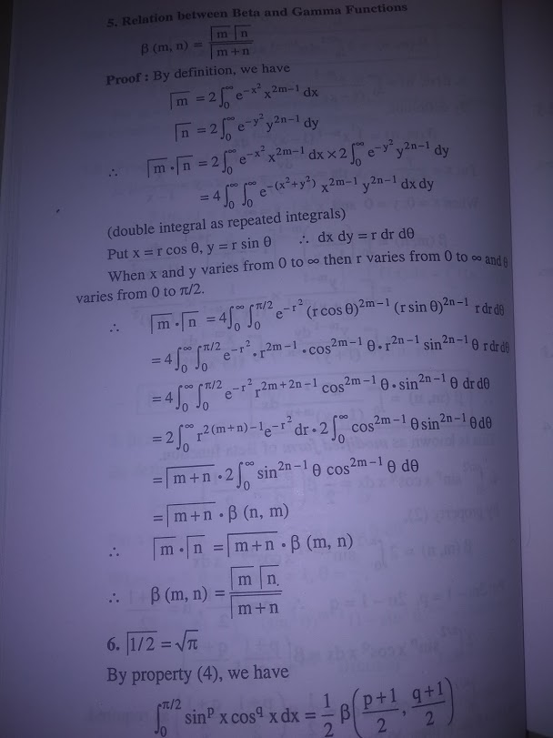

Slide 10
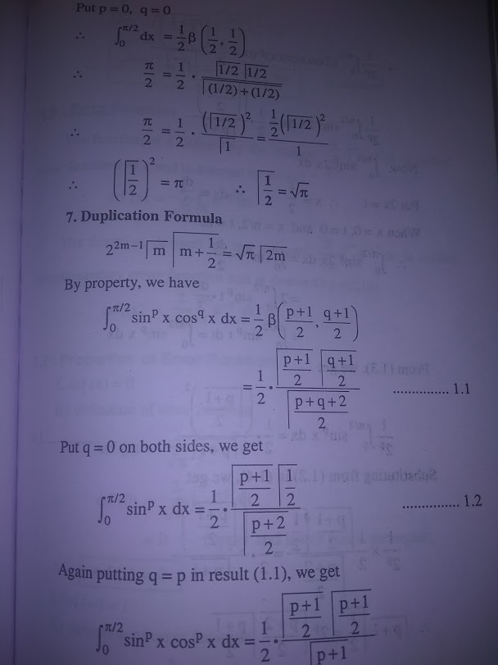

Slide 11
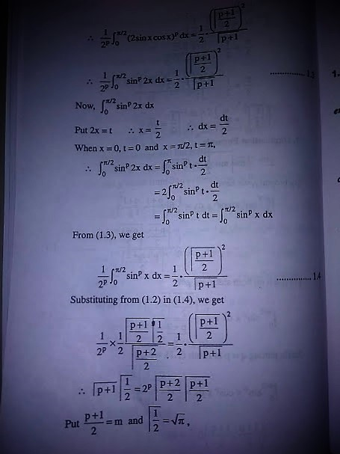

Slide 12
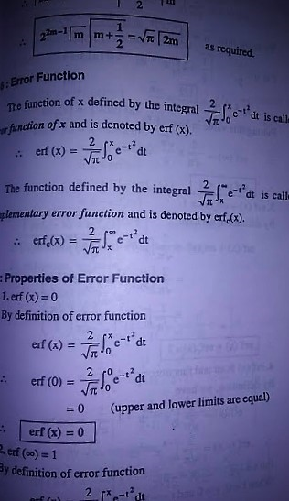

Slide 13
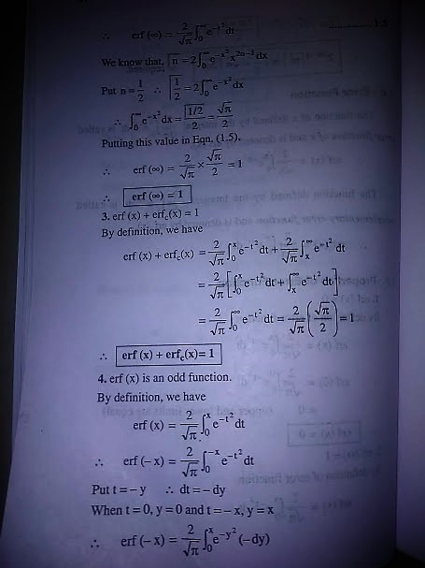

Slide 14
